Slide 1
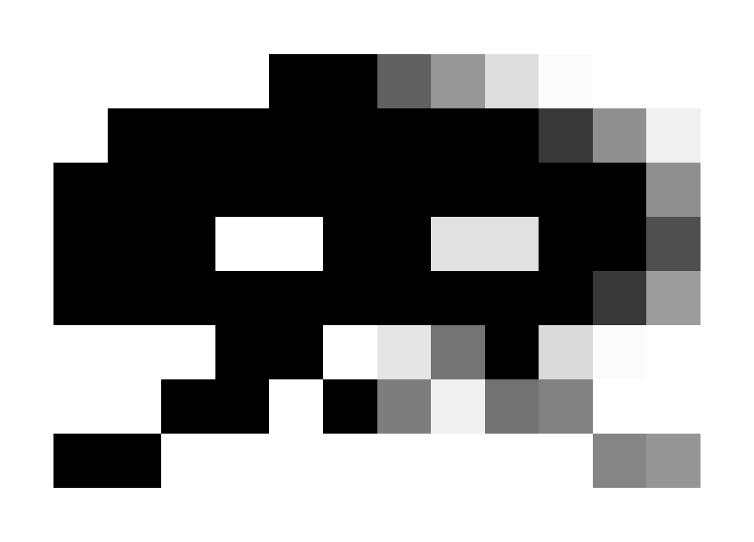
Filtering Approaches for
Real-Time Anti-Aliasing
http://www.iryoku.com/aacourse/

Slide 2
Filtering Approaches for Real-Time Anti-Aliasing
Jimenez’s MLAA &
SMAA: Subpixel Morphological Anti-Aliasing
Jorge Jimenez
Universidad de Zaragoza
jorge@iryoku.com
Notes:
Hi,
I’m Jorge Jimenez, from the Universidad de Zaragoza, Spain.
Up to now, Alex has been talking about his original, CPU-based MLAA.
My presentation is about how we transformed this technique into a very efficient GPU shader, and the improvements we introduced.

Slide 3
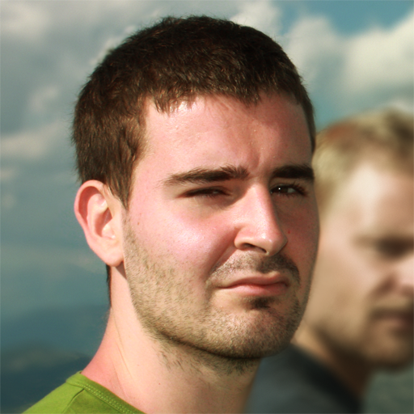
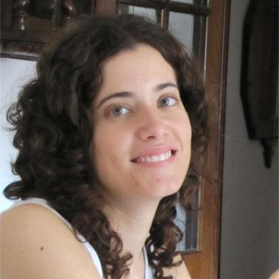

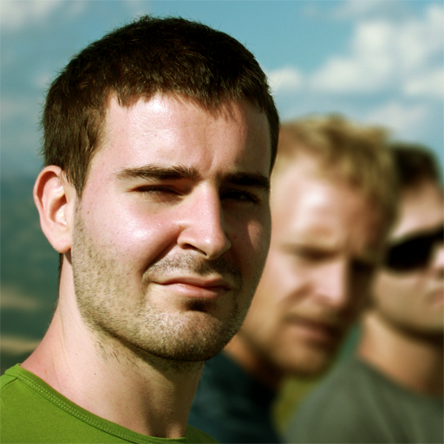
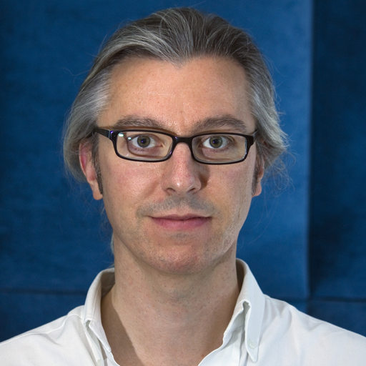
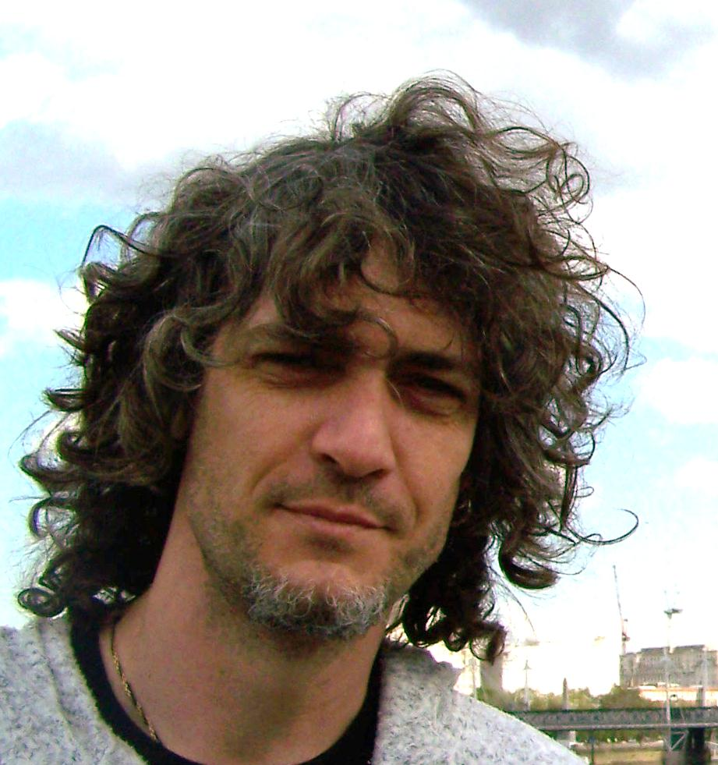
The Team
Jorge Jimenez
Universidad de Zaragoza
Belen
Masia
Universidad de Zaragoza
Jose I. Echevarria
Universidad de Zaragoza
Fernando Navarro
Lionhead Studios
Diego Gutierrez
Universidad de Zaragoza
Practical Morphological Anti-Aliasing
In GPU Pro 2: Advanced Rendering Techniques
Notes:
But, first of all, here you have all the team members that made this technique possible.

Slide 4
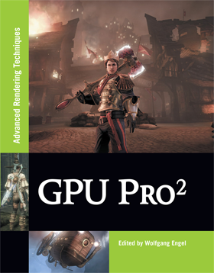
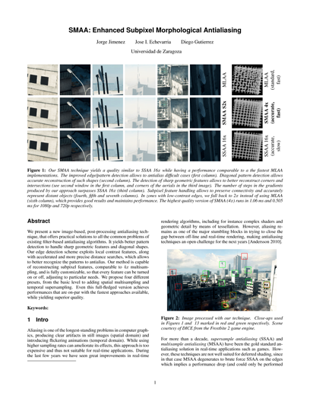
Practical Morphological Anti-Aliasing
In GPU Pro 2: Advanced Rendering Techniques
SMAA: Subpixel Morphological Anti-Aliasing
Technical Report
Notes:
It has been published in GPU Pro 2, and there has been some improvements ever since.
So, I’ll be giving you a sneak preview [click] of our latest-latest technique, which we have just published as a tech report (but more on that later).

Slide 5
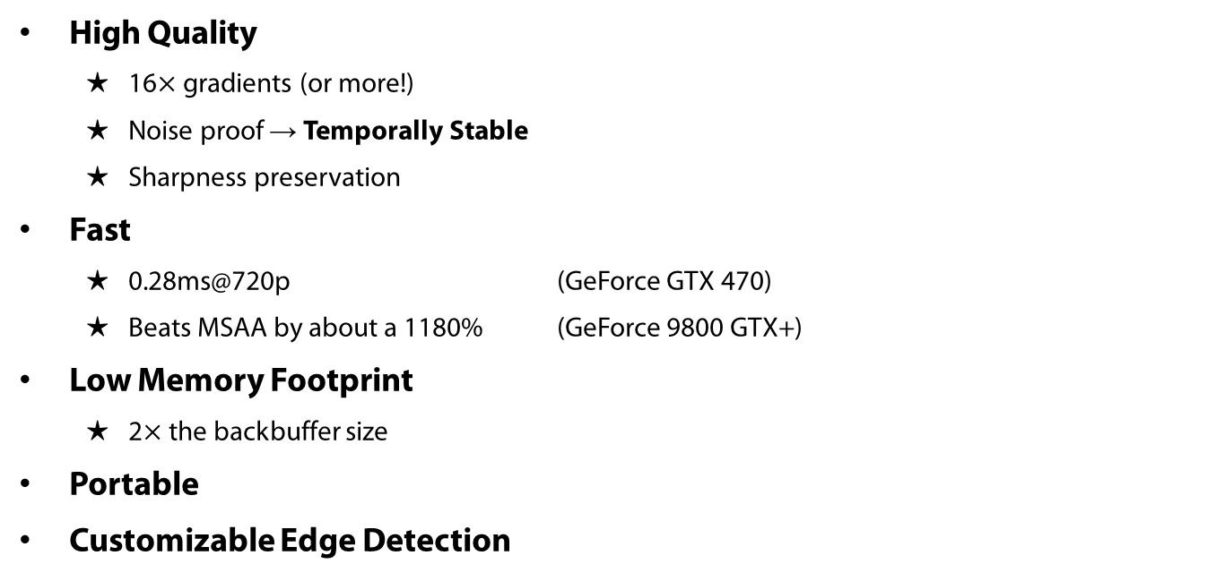
Key Features
High Quality
  16$×$gradients (or more!)
  Noise proof → Temporally Stable
  Sharpness preservation
Fast
  0.28ms@720p (GeForce GTX 470)
  Beats MSAA by about a 1180% (GeForce 9800 GTX+)
Low Memory Footprint
  2$×$ the backbuffer size
Portable
Customizable Edge Detection
Practical Morphological Anti-Aliasing
In GPU Pro 2: Advanced Rendering Techniques
Notes:
During the development of our technique we had to decide on several tradeoffs.

Slide 6
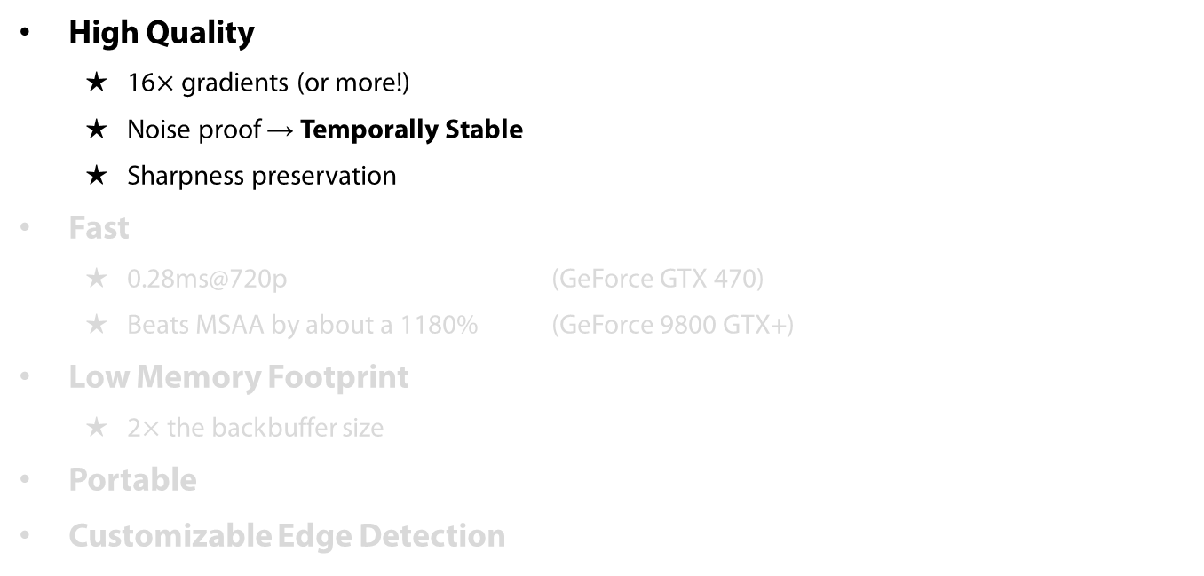
Key Features
High Quality
  16$×$gradients (or more!)
  Noise proof → Temporally Stable
  Sharpness preservation
Fast
  0.28ms@720p (GeForce GTX 470)
  Beats MSAA by about a 1180% (GeForce 9800 GTX+)
Low Memory Footprint
  2$×$ the backbuffer size
Portable
Customizable Edge Detection
Practical Morphological Anti-Aliasing
In GPU Pro 2: Advanced Rendering Techniques
Notes:
First of all, we put our maximum emphasis, on achieving the highest quality possible:
- We obtain gradients in the silhouette of objects that usually surpass those produced by MSAA 16x.
- In our latest version, we are more temporally stable, with a much better management of noise.
- We are really consevative with the image, as we only touch were it’s really needed, which translates to a better sharpness preservation.

Slide 7
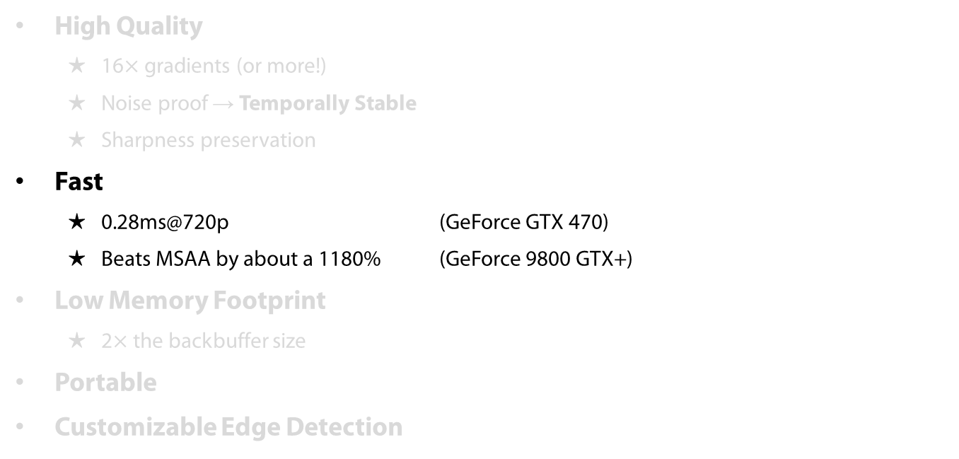
Key Features
High Quality
  16$×$gradients (or more!)
  Noise proof → Temporally Stable
  Sharpness preservation
Fast
  0.28ms@720p (GeForce GTX 470)
  Beats MSAA by about a 1180% (GeForce 9800 GTX+)
Low Memory Footprint
  2$×$ the backbuffer size
Portable
Customizable Edge Detection
Practical Morphological Anti-Aliasing
In GPU Pro 2: Advanced Rendering Techniques
Notes:
Second to high quality, we tried to achieve the best performance possible.
We are quite fast on medium to high-end range of GPUs, running in 0.28 on a GeForce GTX 470 and beating MSAA by a factor of twelve in our older test machine.

Slide 8
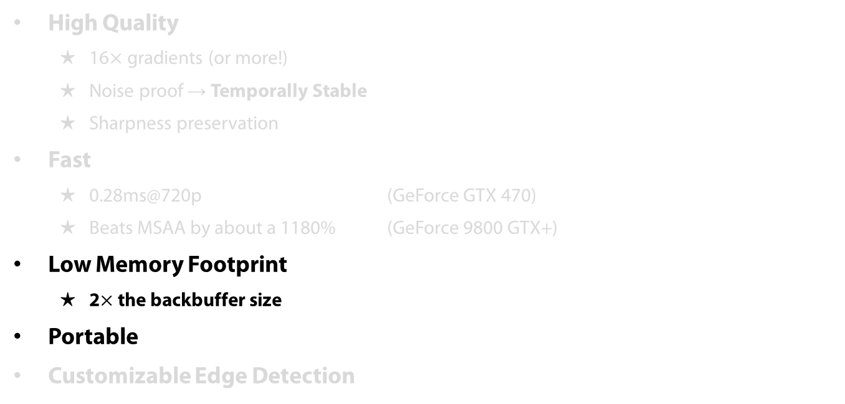
Key Features
High Quality
  16$×$gradients (or more!)
  Noise proof → Temporally Stable
  Sharpness preservation
Fast
  0.28ms@720p (GeForce GTX 470)
  Beats MSAA by about a 1180% (GeForce 9800 GTX+)
Low Memory Footprint
  2$×$ the backbuffer size
Portable
Customizable Edge Detection
Practical Morphological Anti-Aliasing
In GPU Pro 2: Advanced Rendering Techniques
Notes:
Also, we have a low memory footprint and we are easily portable.

Slide 9
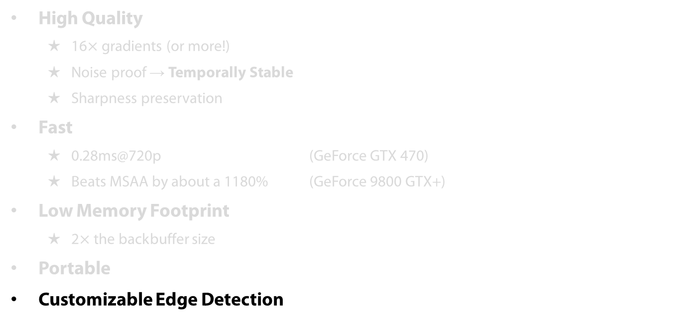
Key Features
High Quality
  16$×$gradients (or more!)
  Noise proof → Temporally Stable
  Sharpness preservation
Fast
  0.28ms@720p (GeForce GTX 470)
  Beats MSAA by about a 1180% (GeForce 9800 GTX+)
Low Memory Footprint
  2$×$ the backbuffer size
Portable
Customizable Edge Detection
Practical Morphological Anti-Aliasing
In GPU Pro 2: Advanced Rendering Techniques
Notes:
The edge detection step can be customized to use color, depth, instance ids, normals, primitive ids, or any combination of them, as Alexander already mentioned.
This allows to select the best method for a particular scenario.
We believe the method used in Killzone 3, described later on by Tobias, could be one of the best edge detection approaches.

Slide 10
Key Ideas
Translate MLAA to use simple textures
Use pre-computed textures:
  Avoid dynamic branching
  Avoid calculating areas on the fly
Leverage bilinear filtering to the limit
Share calculations between pixels (pixels share edges!)
Mask operations by using the stencil buffer
Notes:
I would like to begin with the key, high-level ideas of our technique.
For this, let’s forget about this boring slide and begin with what the original CPU based approach does, and how we replace each component into a more GPU-friendly form.

Slide 11
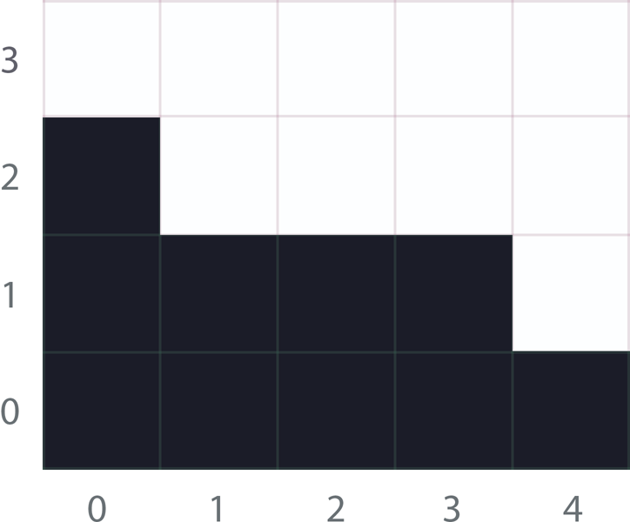
MLAA High-Level Algorithm
Notes:
So, say we want to antialias this image.

Slide 12
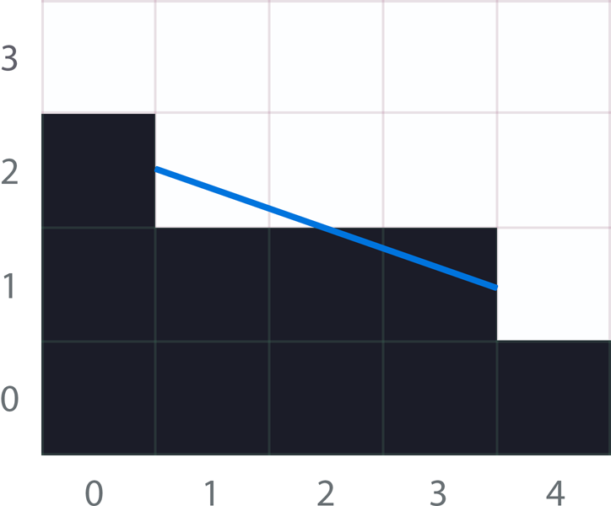
MLAA High-Level Algorithm
Notes:
For this we have to figure out the blue line, which represents the revectorization of this pixel pattern.

Slide 13
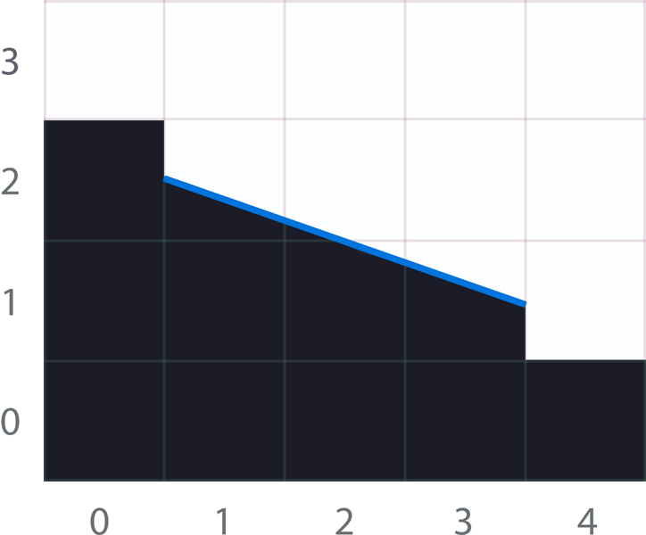
MLAA High-Level Algorithm
Notes:
Using this revectorization, we will fill the areas under the line using the opposite color at each pixel.
So, in the left we fill with black, and on the right, we fill with white.
This is then translated to…

Slide 14
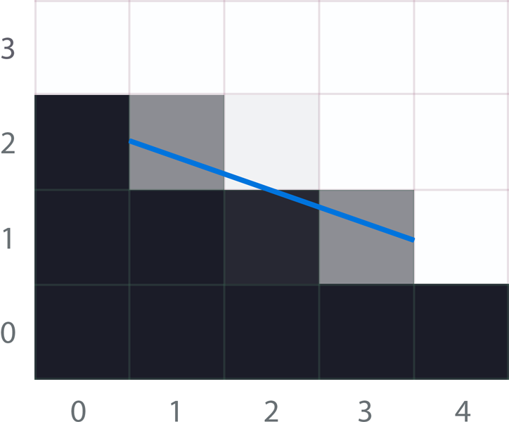
MLAA High-Level Algorithm
Notes:
…gray levels, which approximate the real shape.

Slide 15
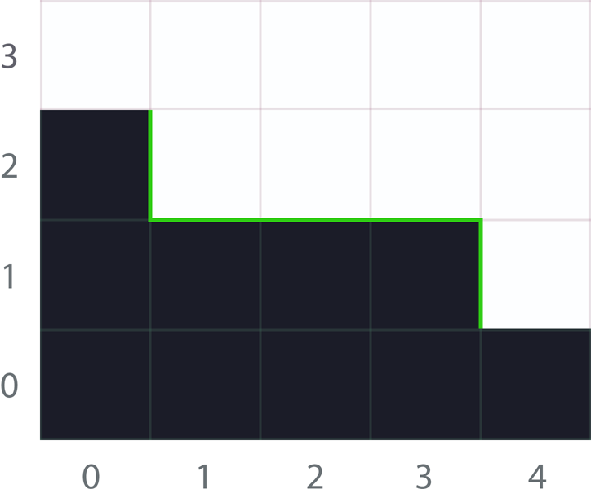
MLAA High-Level Algorithm
Notes:
But, ok, let’s rewind.
The first step is detecting where the edges are, which are the lines marked on green.

Slide 16
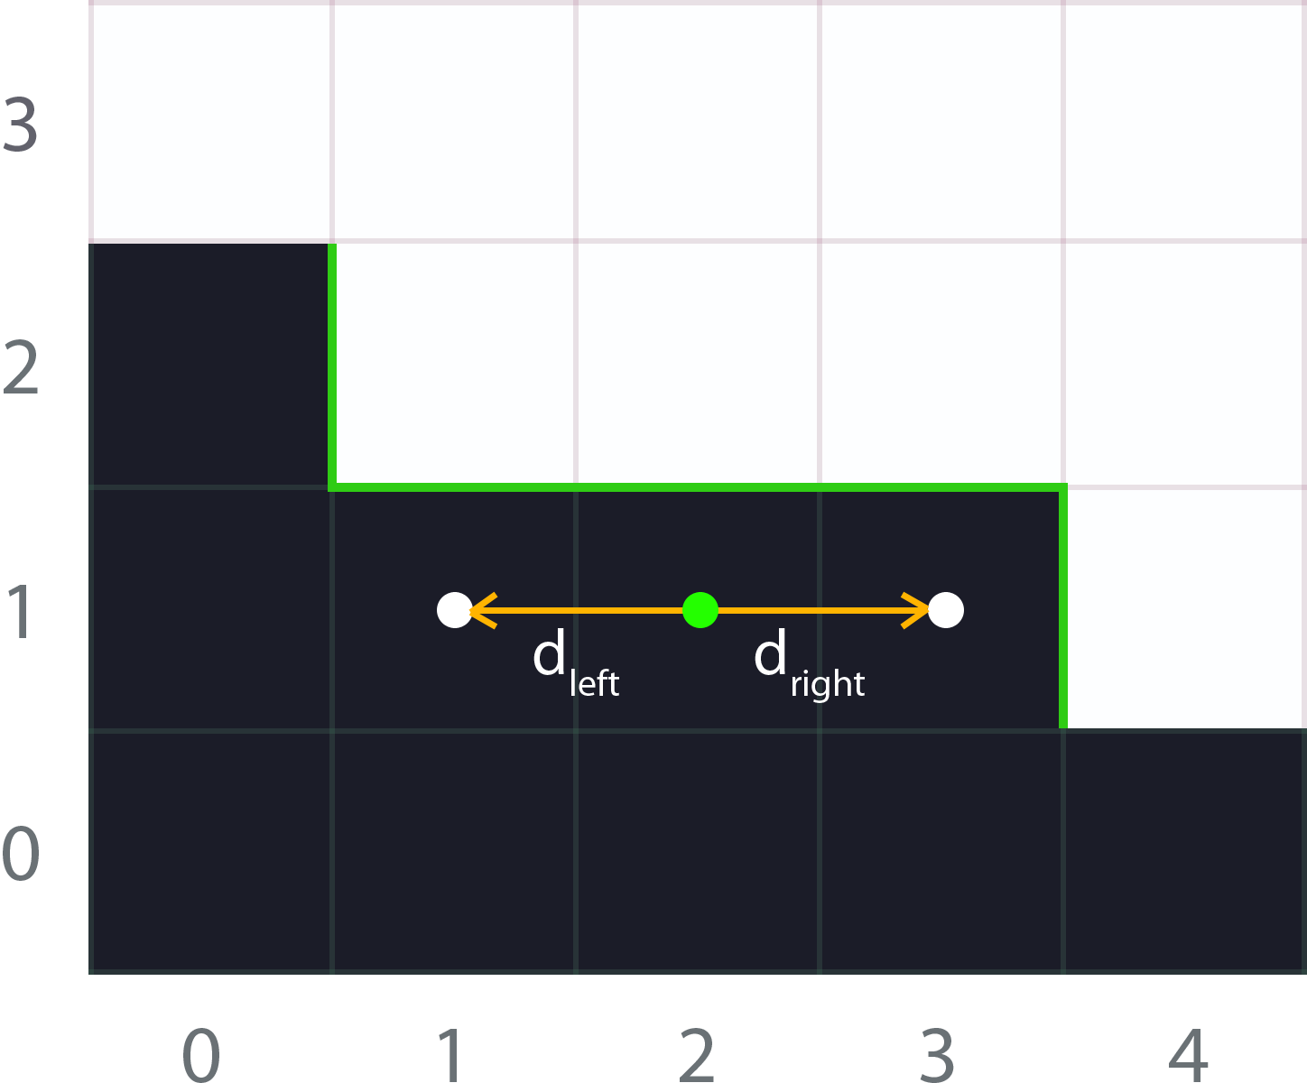
MLAA High-Level Algorithm
Notes:
And now, we have to search for the line ends to the left and to the right.

Slide 17
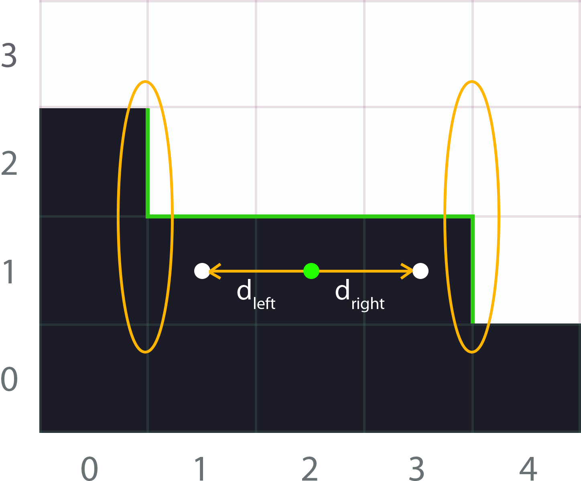
MLAA High-Level Algorithm
Notes:
And, obtain the crossing edges at each side of the line.

Slide 18
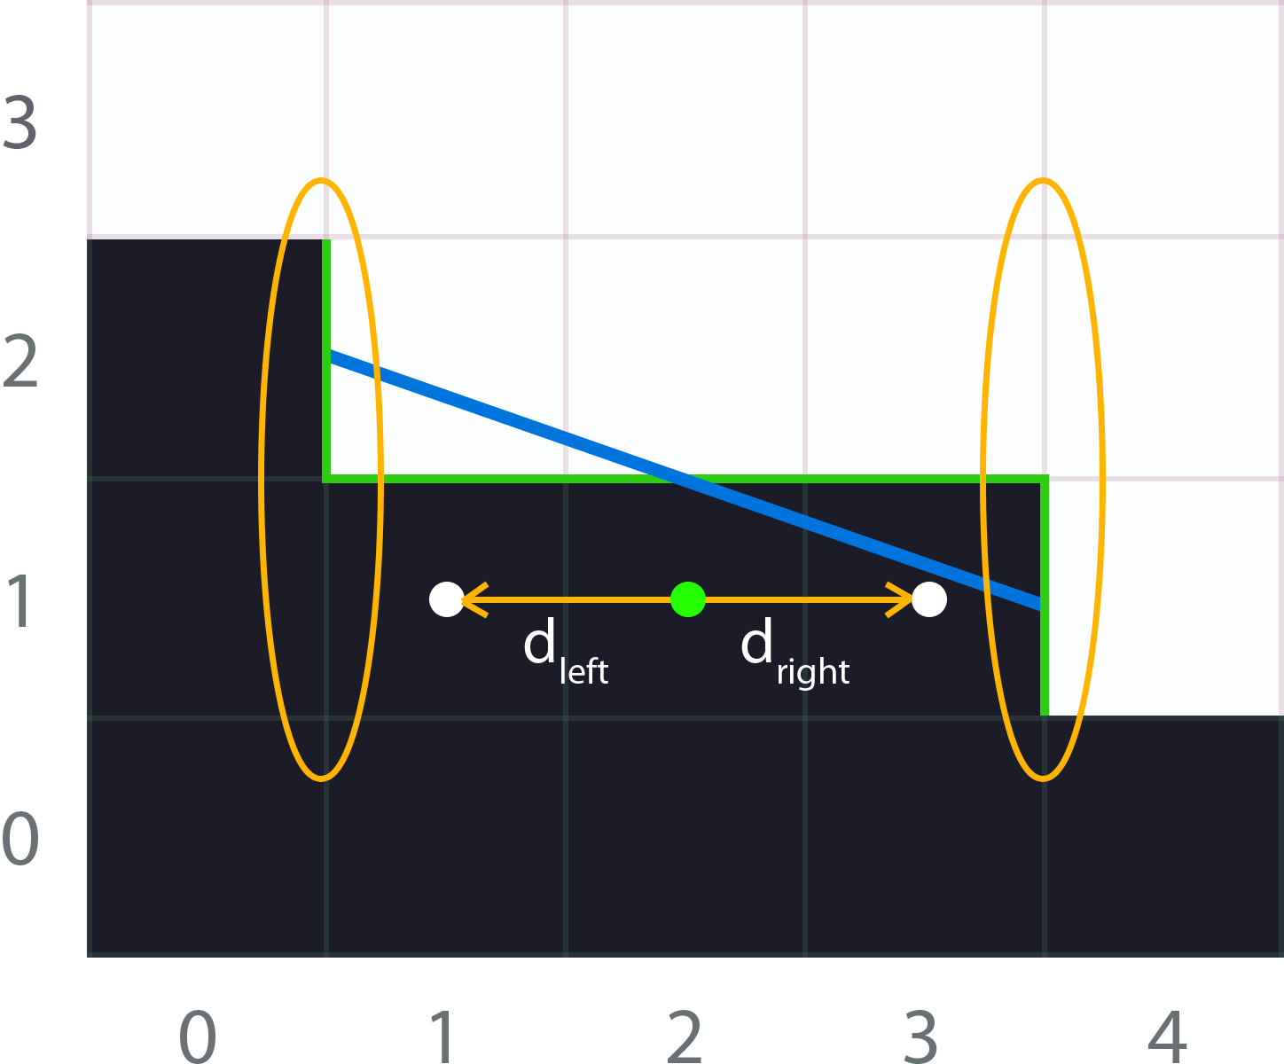
MLAA High-Level Algorithm
Notes:
With the distances and crossing edges at hand, we have enough information for calculating the areas under the revectorized line.
Easy, isn’t it?

Slide 19
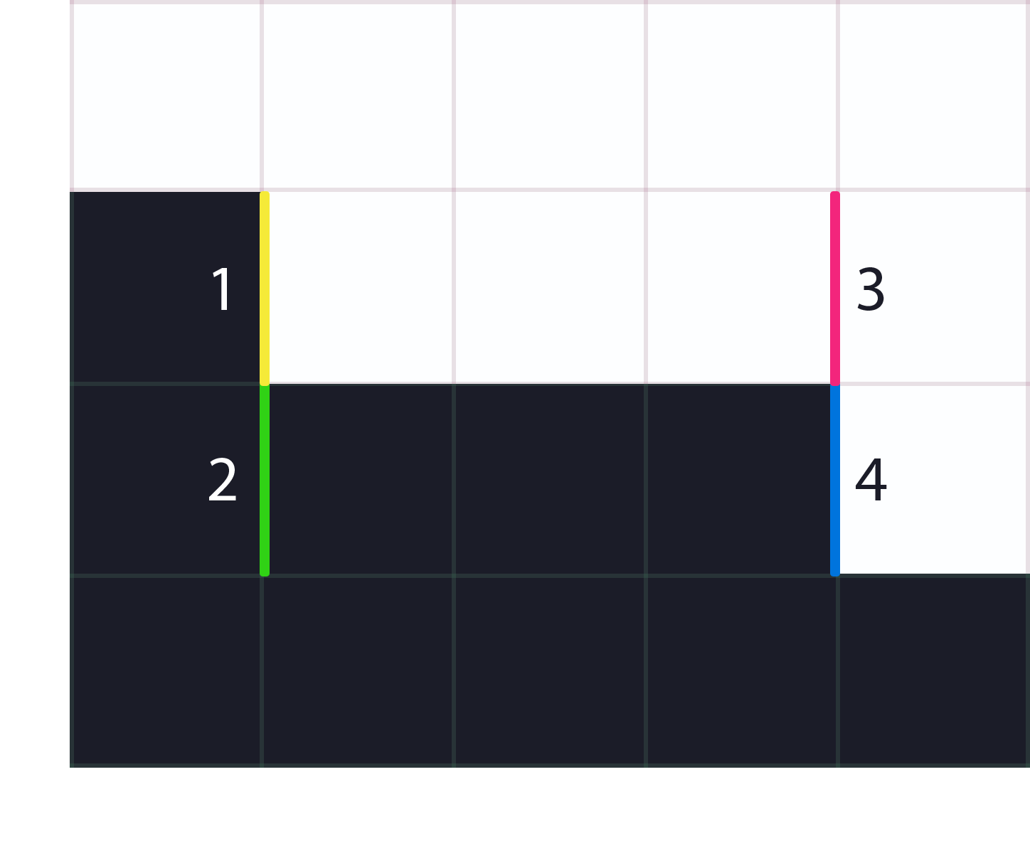
Problems
Searching for ends is slow
Fetching for crossing edges is costly
Revectorization is branchy:
  2⁴ =16 cases!
Area calculation is not cheap
Up to 4 lines per pixel!
Searchs
Crossing Edges
Notes:
But the beauty doesn’t come without problems:
Fetching edges for the searches and crossing edges is slow, as it requires lots of memory bandwidth.

Slide 20
Problems
Searching for ends is slow
Fetching for crossing edges is costly
Revectorization is branchy:
  2⁴ =16 cases!
Area calculation is not cheap
Up to 4 lines per pixel!
Notes:
And even with the crossing edges at hand, the revectorization is not trivial given the high number of possible patterns.

Slide 21
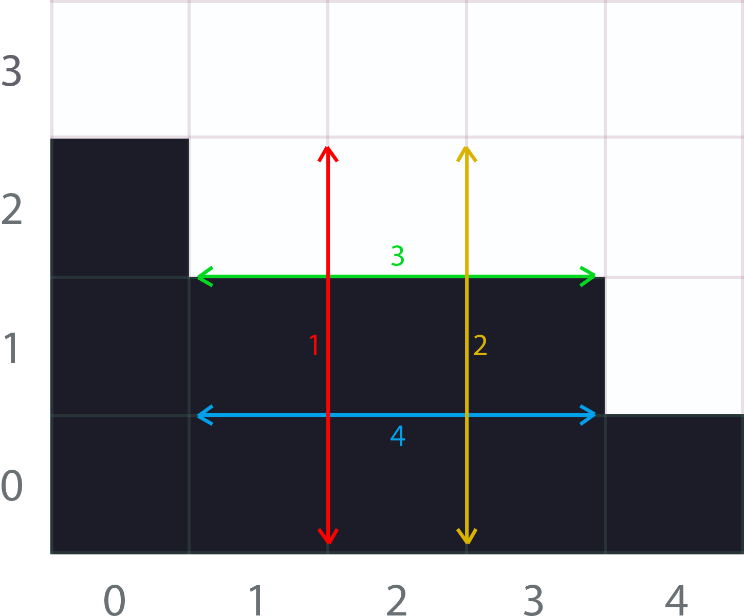
Problems
Searching for ends is slow
Fetching for crossing edges is costly
Revectorization is branchy:
  2⁴ =16 cases!
Area calculation is not cheap
Up to 4 lines per pixel!
Notes:
Furthermore, we have to repeat these calculations up to four times per pixel, one per boundary, which introduces a very huge performance penalty.
So, how can we, solve these problems, without reducing the quality of MLAA?

Slide 22
Solutions
Searching for line ends is slow
Fetching for crossing edges is costly
Solution: introduce bilinear filtering to post processing antialiasing
  This allows to fetch multiple values in a single access!
Notes:
To improve the searches for line ends and the fetching of crossing edges, which is the most expensive component of MLAA, we introduce bilinear filtering to accelerate post processing antialiasing.
This allows to fetch multiple values in a single access.

Slide 23
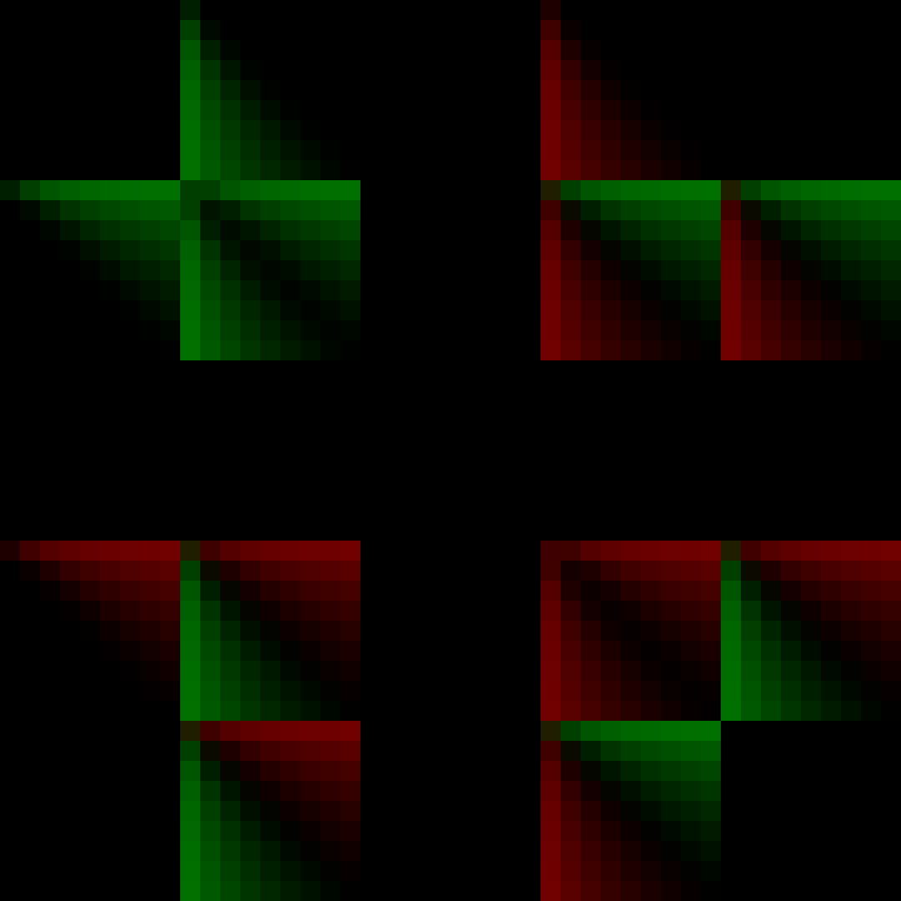
Solutions
Calculating the revectorization is not easy nor fast
Accurate area calculation is not cheap
Solution: avoid branchy code by using a precomputed texture
distances
crossing edges
area
Notes:
Then, for easing the revectorization and area calculation we built a texture which takes as input the distances and crossing edges and, outputs the area under the line.
This transforms the whole branchy code to discern between the sixteen cases, and the area calculation into a single texture access.

Slide 24
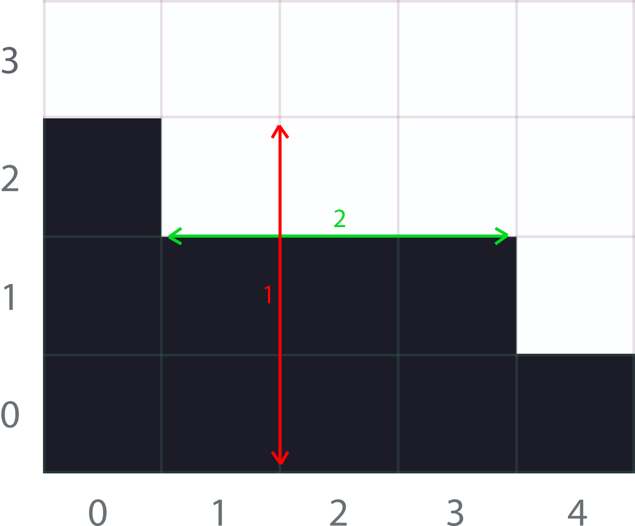
Solutions
Up to 4 lines can pass through a pixel
Solution: stupid observation; pixels share edges, don’t repeat calculations!
Notes:
While it’s true that four lines can pass through a pixel, they are shared with the neighbors.
So, instead of searching for the four lines, we search just for the top and left lines,
Then, we calculate the corresponding areas, and store them into a temporal buffer.
This allows to share this information with the neighbors, at the cost of introducing another pass.

Slide 25
New Problem!
We now require three full-screen passes
Solution: use the stencil buffer!
Notes:
But, now we got a new problem: we require three fullscreen passes.
However, the solution is easy:
[click]
Mask pixels that need procesing in the first pass using the stencil buffer.

Slide 26
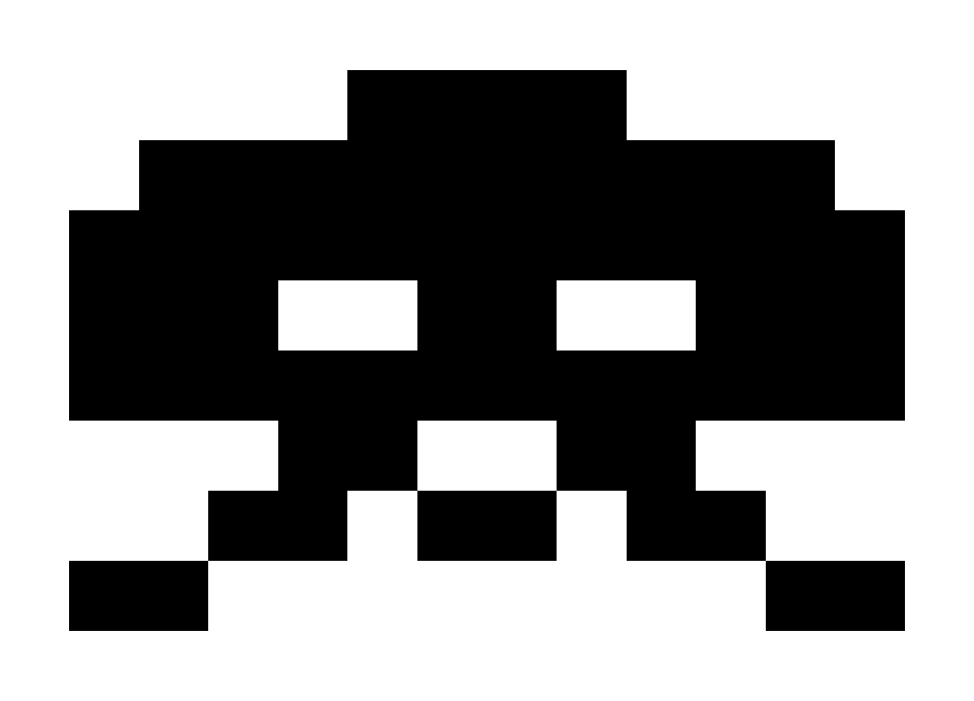
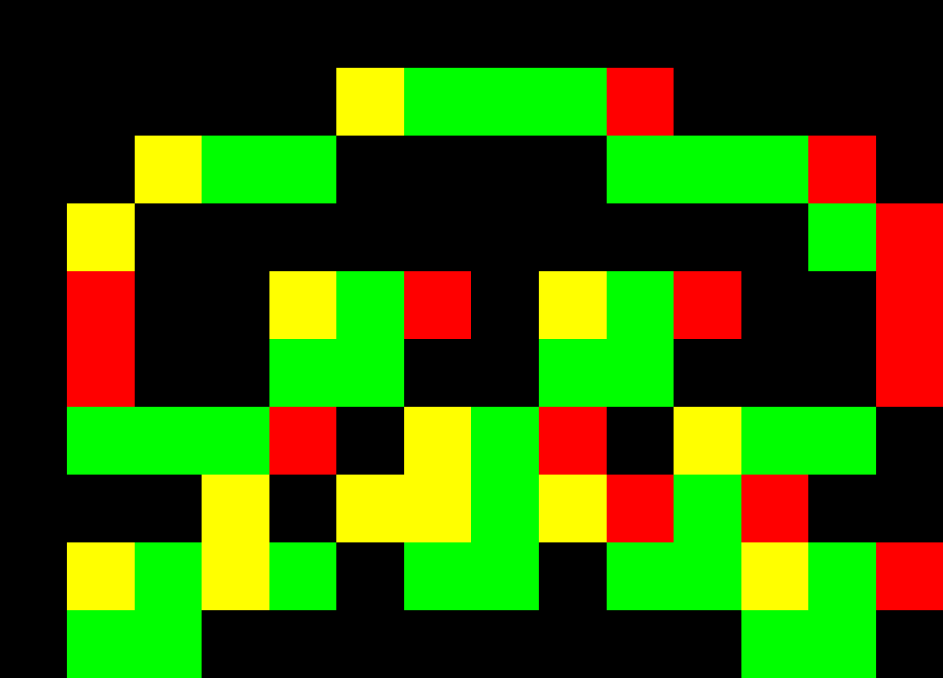
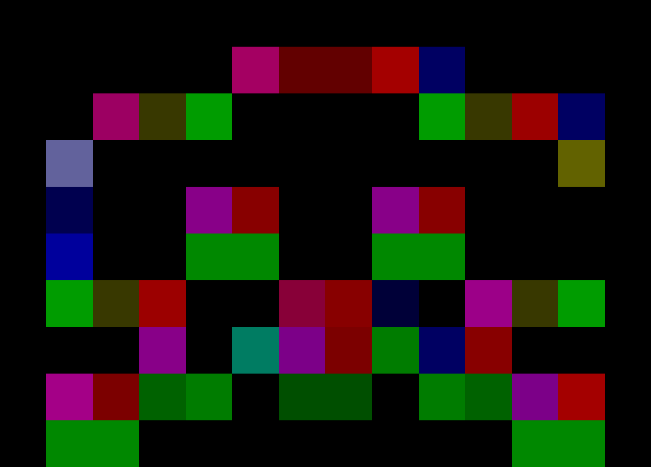
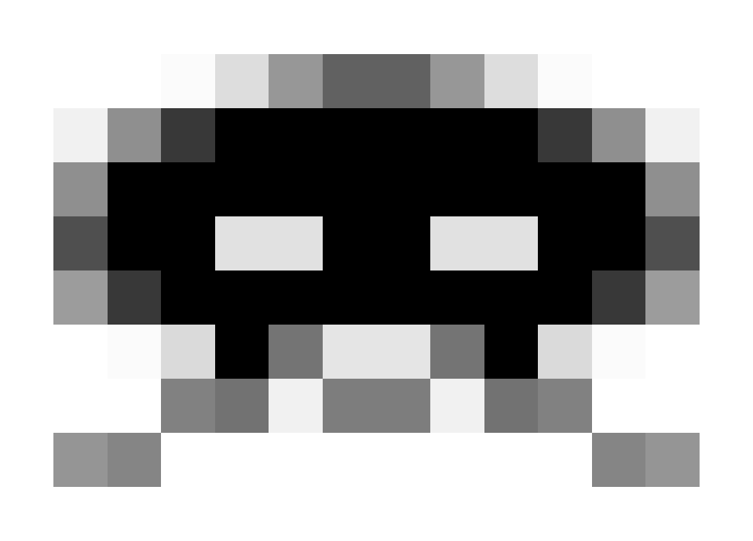
Workflow
Original Image
Edges texture
Blending weights texture
Antialiased Image
Notes:
Ok, so we finished with the high level idea, now, let’s dive into the details of our implementation.
Here you have the big picture of our technique.
It consists on three passes.

Slide 27
Workflow
Original Image
Edges texture
Blending weights texture
Antialiased Image
1st
Notes:
In the first pass, we perform edge detection, obtaining the edges texture.

Slide 28
Workflow
Original Image
Edges texture
Blending weights texture
Antialiased Image
1st
2nd
Notes:
In the second pass, we process each edge, calculating the revectorizations and obtaining the corresponding areas.

Slide 29
Workflow
Original Image
Edges texture
Blending weights texture
Antialiased Image
1st
2nd
3rd
Notes:
In the third and final pass, we blend each pixel with its four-neighborhood, using the areas from the second pass.
I’m going to skip the edge detection step and go straight to the second one, which has a more interesting implementation.

Slide 30
Edge Detection 1st Pass
Color: (ITU-R Recommendation BT.709)
  Y' = 0.2126 · R' + 0.7152 · G' + 0.0722 · B’
Depth: cheaper and more clean edges, but cannot work at all object scales
Instance ids/depth + normals: the best if you have this information available
1st
Notes:
So, let’s begin with the first pass.
Edge detection is a critical step for the quality of the final image.
Each undetected edge will remain aliased in the final image, so detecting all perceptible edges is crucial.
Robustness in this step is also desirable, given that good edge detection enhances temporal stability.
There are multiple options; which one is the best will depend largely on the particular scenario.

Slide 31
Edge Detection 1st Pass
Color: (ITU-R Recommendation BT.709)
  Y' = 0.2126 · R' + 0.7152 · G' + 0.0722 · B’
Depth: cheaper and more clean edges, but cannot work at all object scales
Instance ids/depth + normals: the best if you have this information available
1st
Notes:
Color can be considered the most universal and easier solution, as it’s always available.
Working with color additionally provides seamless handling of shading aliasing, which may improve quality in some scenarios.
On the downside, it may introduce a slightly blur on text appearing on models, and other high-frequency features.

Slide 32
Edge Detection 1st Pass
Color: (ITU-R Recommendation BT.709)
  Y' = 0.2126 · R' + 0.7152 · G' + 0.0722 · B’
Depth: cheaper and more clean edges, but cannot work at all object scales
Instance ids/depth + normals: the best if you have this information available
1st
Notes:
Depth, normals or object IDs can also be used,
as they are better estimators for geometrical edges,
allowing to maintain the maximum image sharpness.
Using only depth is tricky as it’s really hard to manage all object scales properly, as Pete will show later on.

Slide 33
Edge Detection 1st Pass
Color: (ITU-R Recommendation BT.709)
  Y' = 0.2126 · R' + 0.7152 · G' + 0.0722 · B’
Depth: cheaper and more clean edges, but cannot work at all object scales
Instance ids/depth + normals: clean, sharp but more expensive
1st
Notes:
Combining depth and instance ids with normals leads to very good results in general,
As they produce really clean and complete edges,
Managing to preserve most of the image sharpness.
However the edge detection pass is more expensive given the extra work required.
Sometimes they also introduce artifacts that color doesn’t, but explaining them are out of the scope of this talk.

Slide 34
Edge Detection 1st Pass
Color version:
float4 ColorEdgeDetectionPS(float4 position : SV_POSITION,
float2 texcoord : TEXCOORD0) : SV_TARGET {
float3 weights = float3(0.2126,0.7152, 0.0722);
/**
* Luma calculation requires gamma-corrected colors, and thus 'colorTex' should
* be a non-sRGB texture.
*/
float L = dot(colorTex.SampleLevel(PointSampler, texcoord, 0).rgb, weights);
float Lleft = dot(colorTex.SampleLevel(PointSampler, texcoord, 0, -int2(1, 0)).rgb, weights);
float Ltop = dot(colorTex.SampleLevel(PointSampler, texcoord, 0, -int2(0, 1)).rgb, weights);
float Lright = dot(colorTex.SampleLevel(PointSampler, texcoord, 0, int2(1, 0)).rgb, weights);
float Lbottom = dot(colorTex.SampleLevel(PointSampler, texcoord, 0, int2(0, 1)).rgb, weights);
float4 delta = abs(L.xxxx - float4(Lleft, Ltop, Lright, Lbottom));
float4 edges = step(threshold.xxxx, delta);
if (dot(edges, 1.0) == 0.0)
discard;
return edges;
}
1st
Notes:
Here you can see the simplest form of edge detection, using color input data.
It uses five [click] memory accesses and a few arithmetic operations.
In platforms where Gather4 is available…

Slide 35
Edge Detection 1st Pass
Color version:
float4 ColorEdgeDetectionPS(float4 position : SV_POSITION,
float2 texcoord : TEXCOORD0) : SV_TARGET {
/**
* Luma calculation requires gamma-corrected colors, and thus 'colorTex' should
* be a non-sRGB texture.
*/
float4 topLeft = lumaTex.Gather(LinearSampler, texcoord + PIXEL_SIZE * float2(-0.5, -0.5), 0);
float4 bottomRight = lumaTex.Gather(LinearSampler, texcoord + PIXEL_SIZE * float2(0.5, 0.5), 0);
float L = topLeft.g;
float Lleft = topLeft.r; float Ltop = topLeft.b;
float Lright = bottomRight.b; float Lbottom = bottomRight.r;
float4 delta = abs(L.xxxx - float4(Lleft, Ltop, Lright, Lbottom));
float4 edges = step(threshold.xxxx, delta);
if (dot(edges, 1.0) == 0.0)
discard;
return edges;
}
1st
Notes:
…we can reduce the number of accesses to 3 and remove all the dot products, given the lumas are precomputed

Slide 36
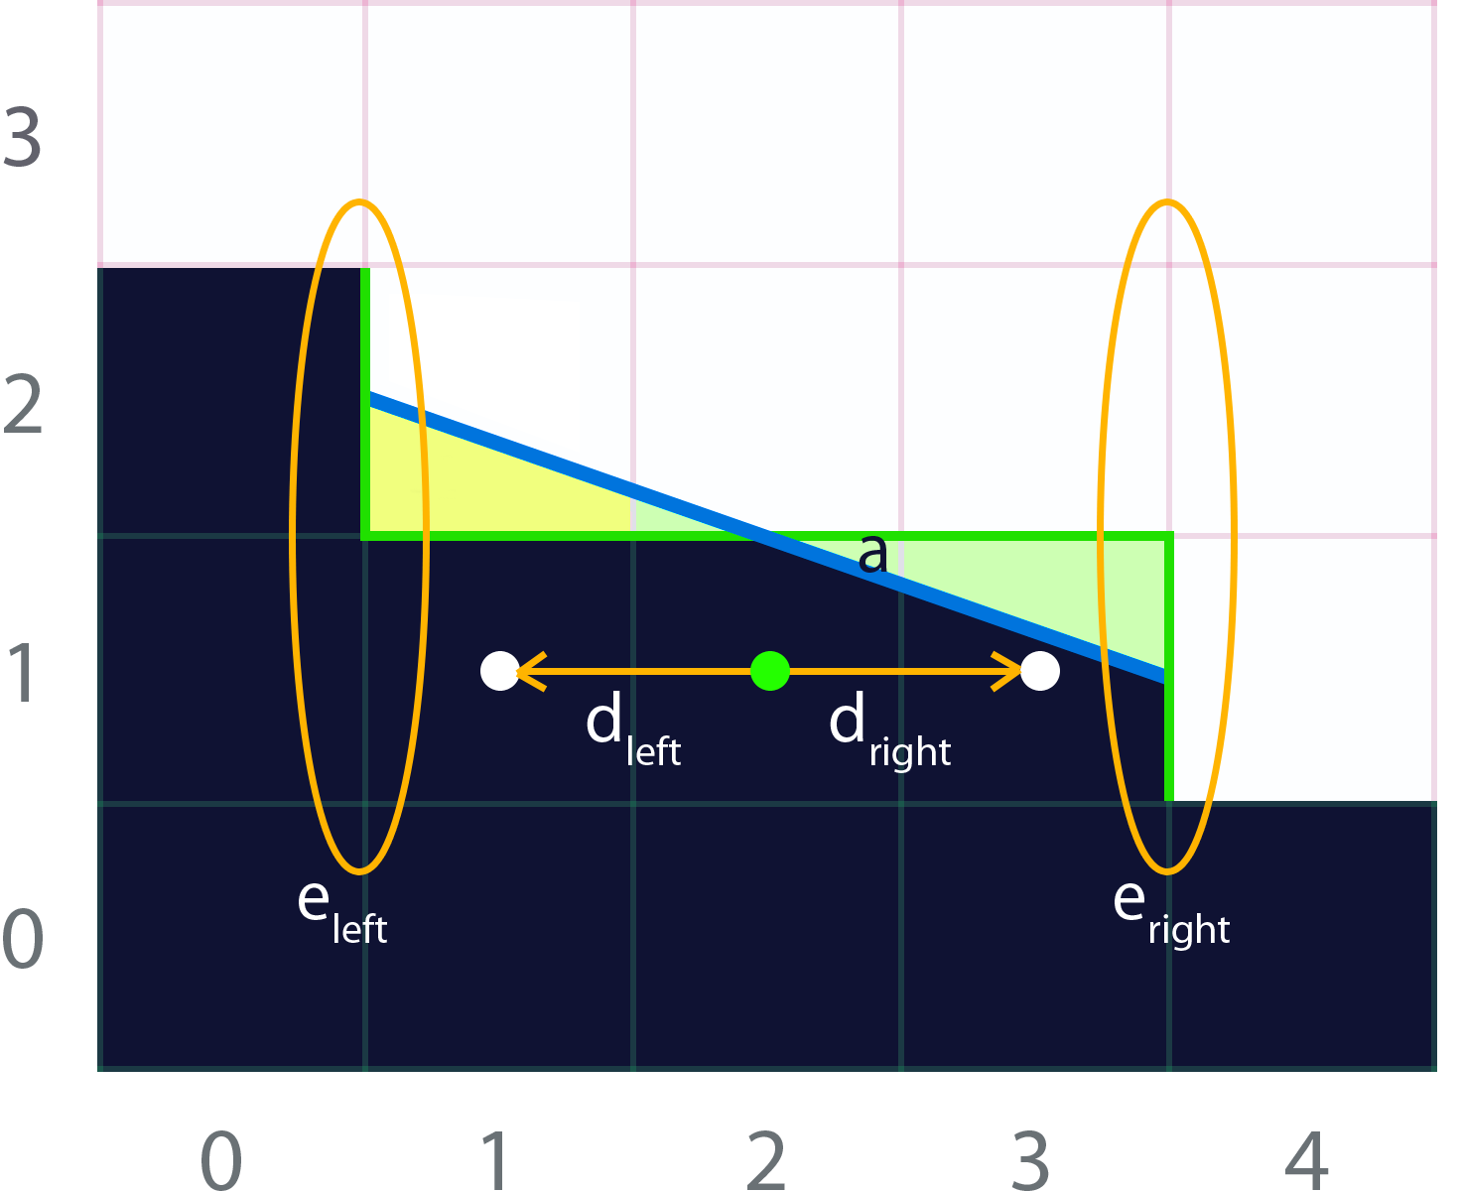
Blending Weights Calculation 2nd Pass
It consists on three parts:
  Searching for distances d_{left} and d_{right} to the end of current line
  Fetching crossing edges e_{left} and e_{right}
  Calculating the coverage a of this pixel, using d and e
2nd
Notes:
So, in this second pass we want to calculate the areas under the revectorized line.
In this pass, we have to search for the ends of the line, to fetch the crossing edges and to use this information to calculate the coverage area of this pixel.

Slide 37
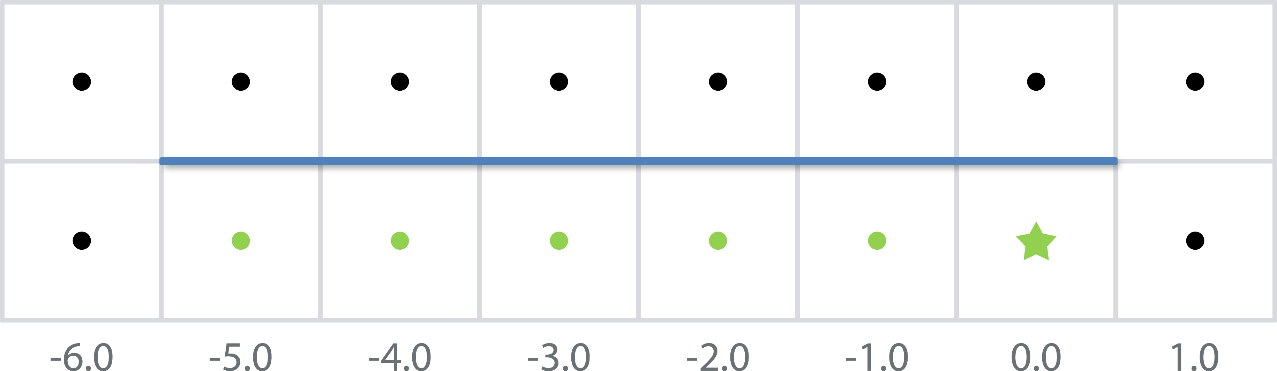
Searching for Distances
Done by exploiting bilinear filtering:
2nd
Notes:
Searching line ends is a memory-intensive task.
So, to improve the bandwidth usage, we leverage the fact that bilinear filtering is free on most platforms.
In this image you have the edge marked on blue, with the colors of the dots representing the values of the edge buffer.
So, starting from here [click], we are going to jump two pixels at time, just between them…

Slide 38
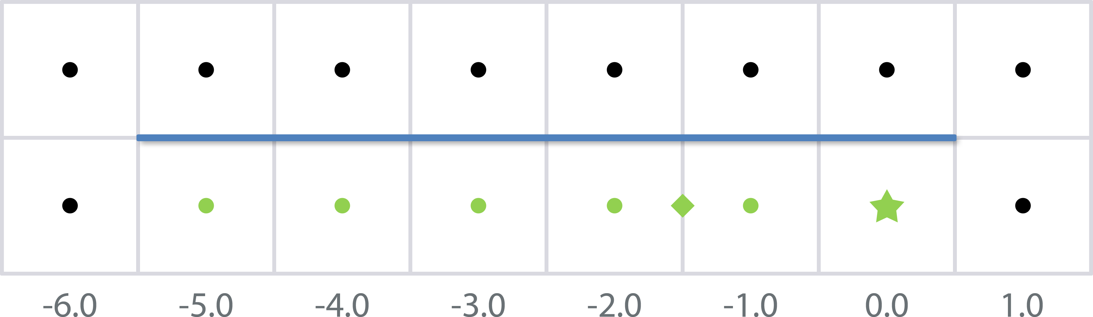
Searching for Distances
Done by exploiting bilinear filtering:
2nd
Notes:
This rombus represent the first fetch.
Bilinear filtering returns one, so there is an edge in both pixels.

Slide 39

Searching for Distances
Done by exploiting bilinear filtering:
2nd
Notes:
The same here…

Slide 40
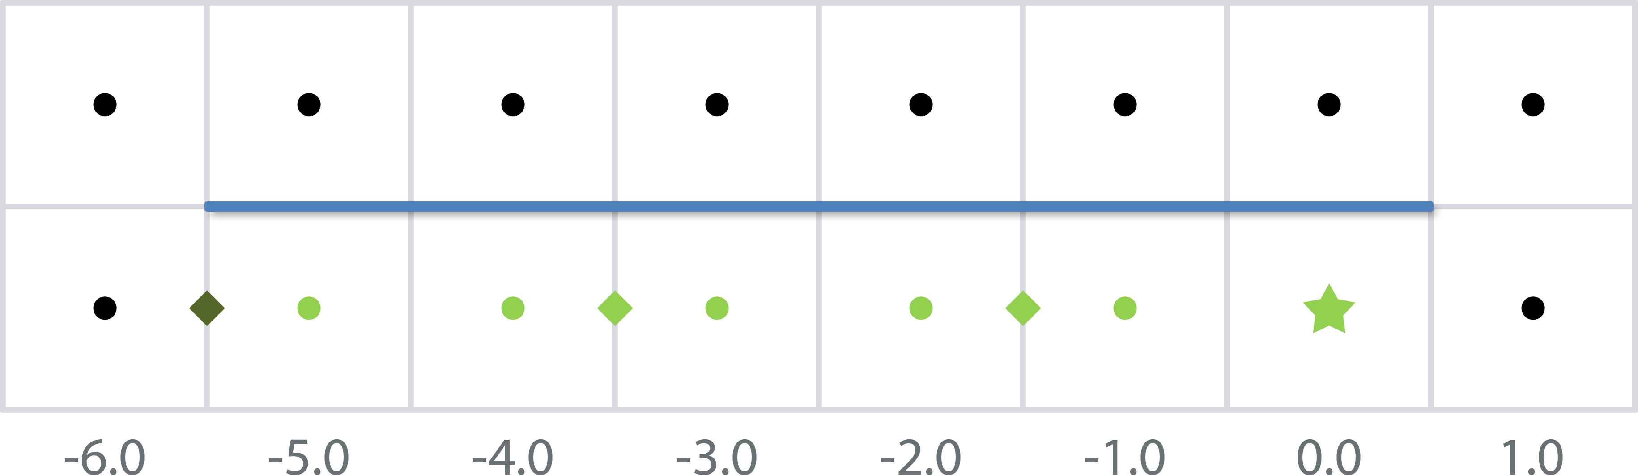
Searching for Distances
Done by exploiting bilinear filtering:
2nd
Notes:
But, in this fetch we obtain 0.5, which means that one of the edges is not active, and thus the search has finished.
By using bilinear filtering in this way, we are able to accelerate searches by a factor of two, allowing to reach really long distance searches without performance drop outs.

Slide 41
Searching for Distances
Search example code:
float SearchXLeft(float2 texcoord) {
texcoord -= float2(1.5, 0.0) * PIXEL_SIZE;
float e = 0.0;
// We offset by 0.5 to sample between edgels, thus fetching two in a row
for (int i = 0; i < maxSearchSteps; i++) {
e = edgesTex.SampleLevel(LinearSampler, texcoord, 0).g;
// We compare with 0.9 to prevent bilinear access precision problems
[flatten] if (e < 0.9) break;
texcoord -= float2(2.0, 0.0) * PIXEL_SIZE;
}
// When we exit the loop without founding the end, we want to return
// -2 * maxSearchSteps
return max(-2.0 * i - 2.0 * e, -2.0 * maxSearchSteps);
}
2nd
Notes:
Here, you have the simple code that handles the searches to the left.
You can see how we jump two pixels at time [click].
And, how we stop when the fetch returns something else than one [click]

Slide 42
Fetching crossing edges
2nd
Notes:
Once we have the distances to the ends of the line, we use them to obtain the crossing edges.
A naïve approach for fetching the crossing edges would imply querying the four edges.

Slide 43
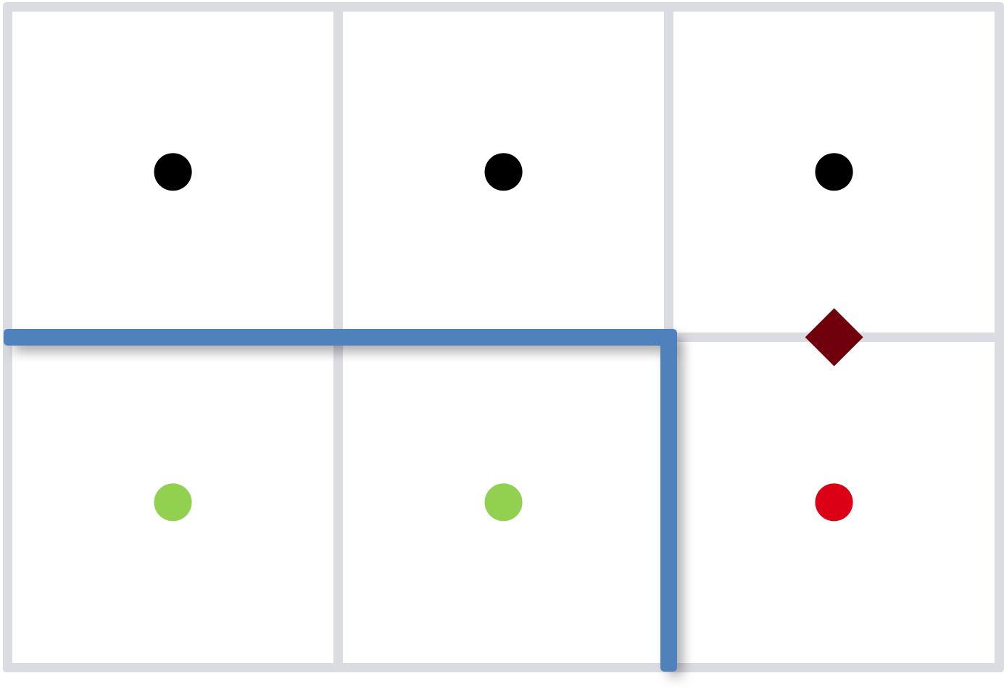
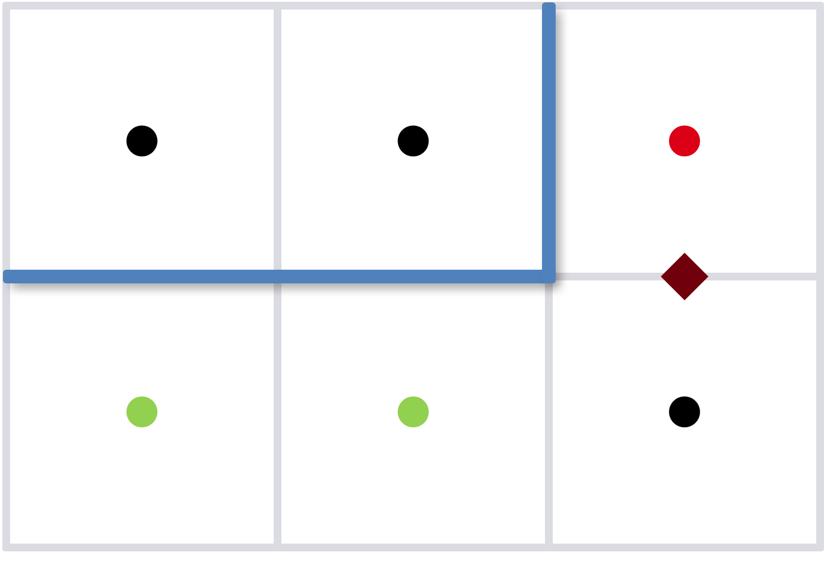
Fetching crossing edges
Again, done by exploiting bilinear filtering
0.5
0.5
2nd
Notes:
Instead, a more efficient approach is to use bilinear filtering for fetching both edges at a time, similar to the distance search.
But, now there is a little problem.
When the return value is 0.5, we are dealing with this case [click]… or this other one [click]?

Slide 44
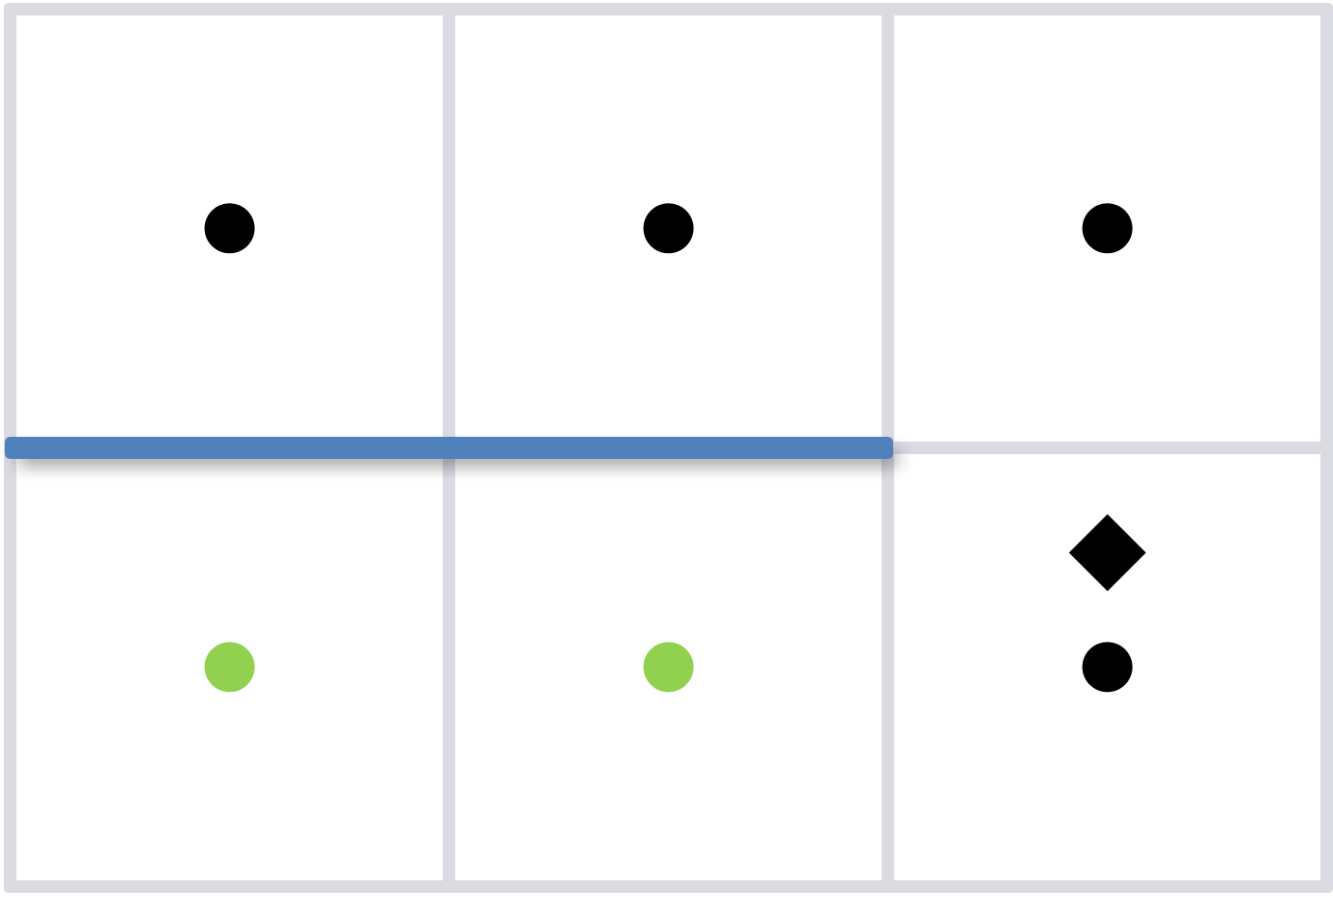
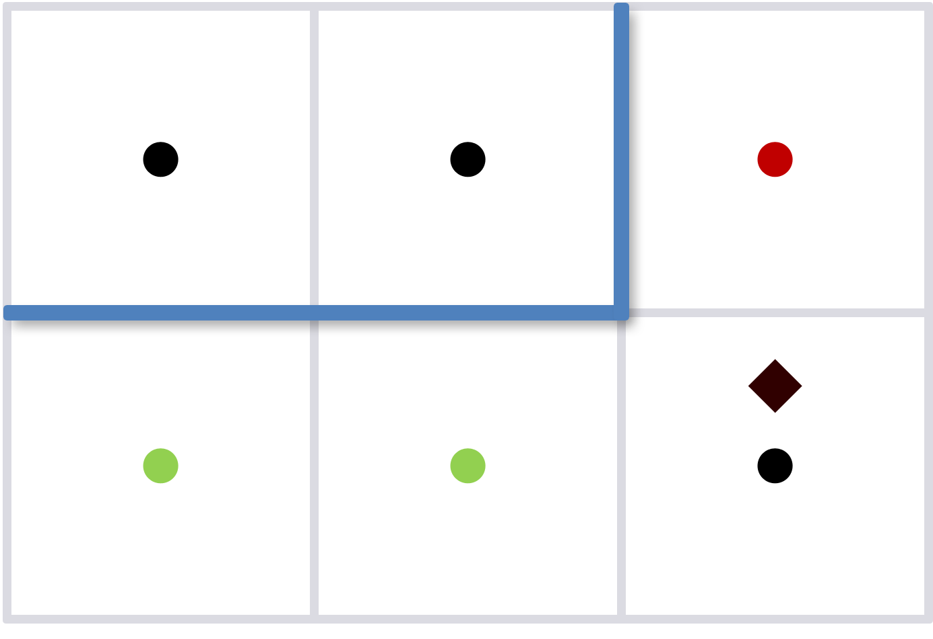
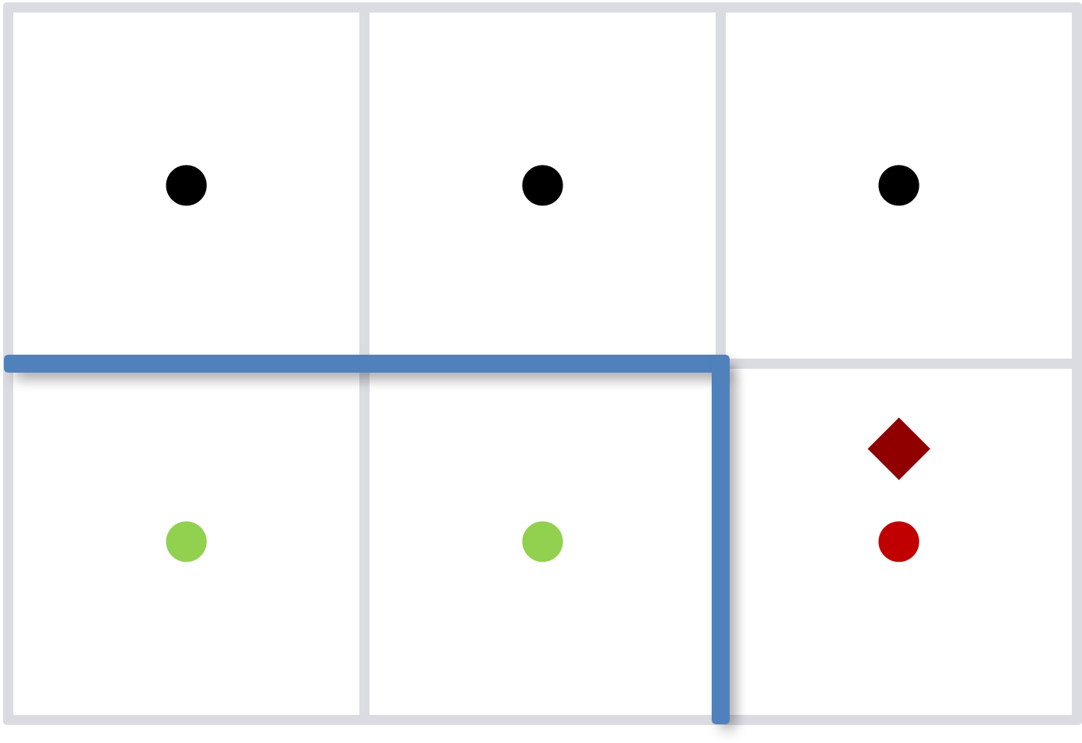
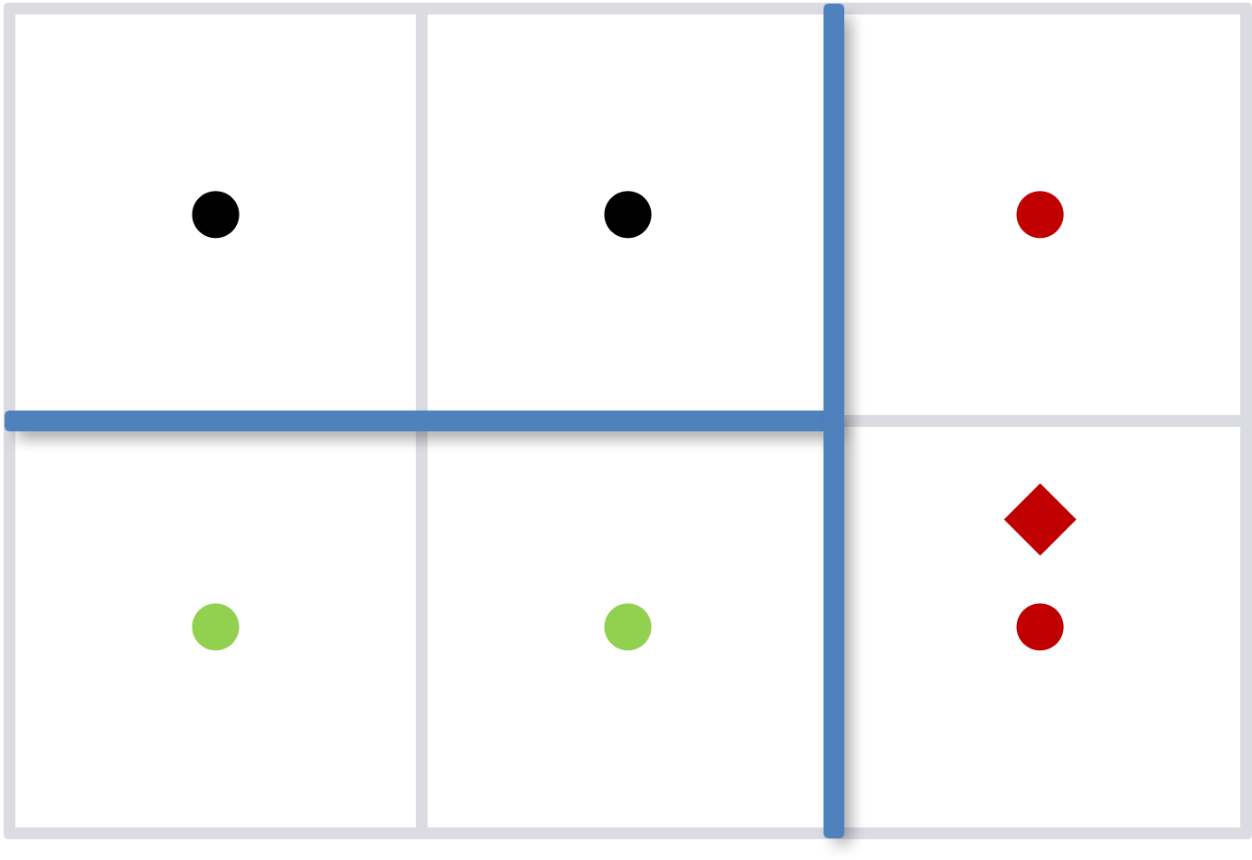
Fetching crossing edges
Solution: offset the coordinates!
0.0
0.25
0.75
1.0
2nd
Notes:
The solution is to offset the query by 0.25 allowing to distinguish them, as the returned value is different in each case.

Slide 45
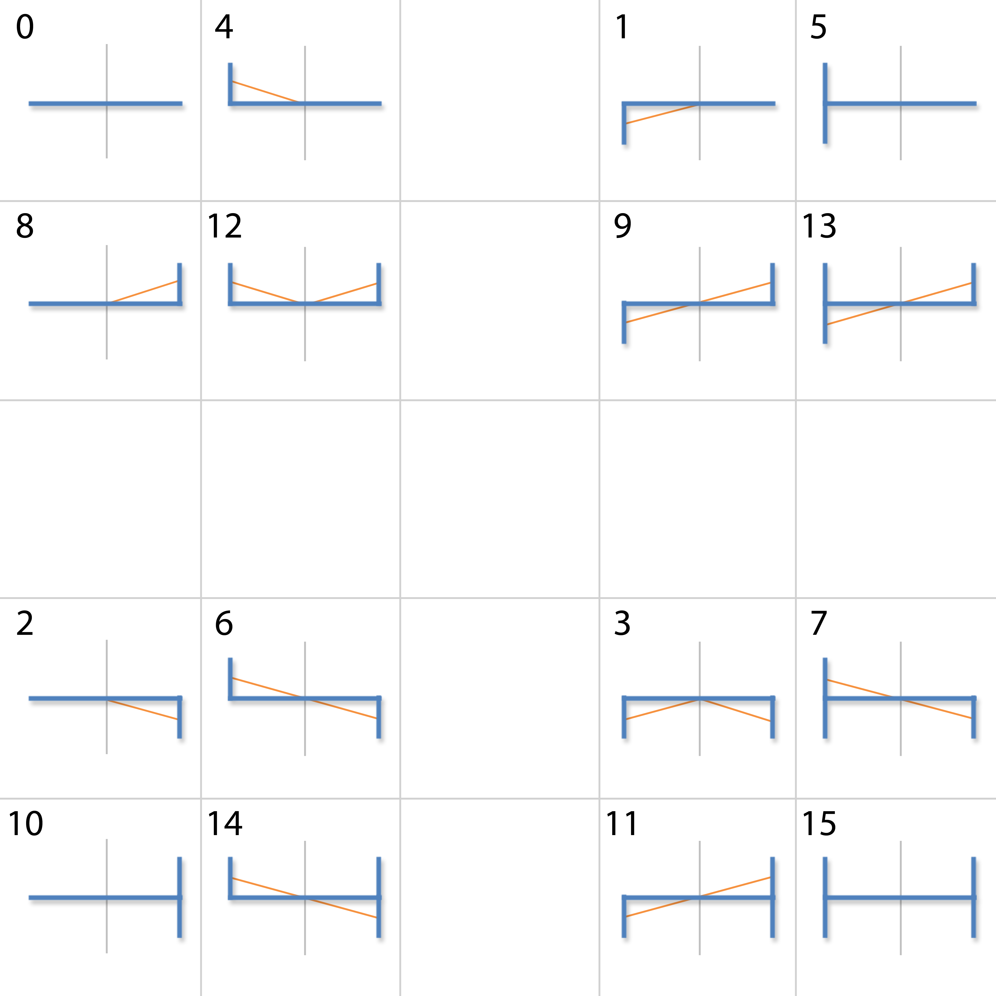
Calculating the coverage
We use a pre-computed texture to avoid:
  Dynamic branching
  Expensive area calculations
2nd
Notes:
A key contribution in the coverage calculation is that, instead of handling sixteen different patterns, we precompute them in a 4D texture [click], which avoids branching code.

Slide 46
Calculating the coverage
2nd
Notes:
Accessing this texture is as follows.
First, the pattern type, or block, is selected…

Slide 47
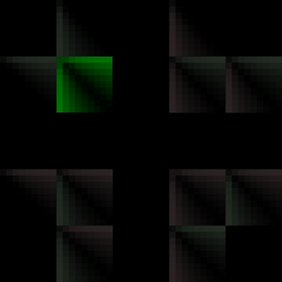


Calculating the coverage
$${4·MaxDistance· e}_{left}$$
$${4·MaxDistance· e}_{right}$$
2nd
Notes:
…by using the crossing edges information.

Slide 48


Calculating the coverage
$${4·MaxDistance· e}_{left}$$
$$d_{left}$$
$$d_{right}$$
$${4·MaxDistance· e}_{right}$$
2nd
Notes:
Then, the proper area is selected by using the distances to the end of the line.

Slide 49
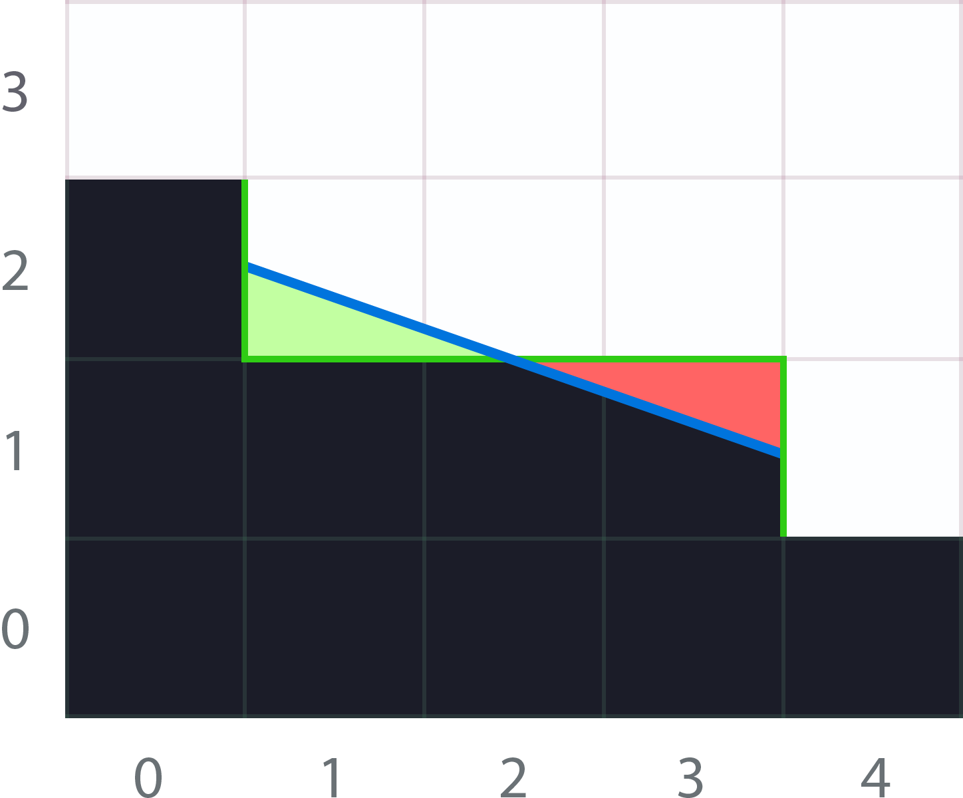
Calculating the coverage
2nd
Notes:
You may be thinking why the precomputed area texture has two channels:
The answer is rather easy, having two channels allows to disambiguate the blend direction.
Red values means the bottom pixel blends with the top one.
While the green values just the opposite.

Slide 50
Area Texture Advatanges
Symetrical handling of patterns
Asymetric revectorization → patterns fine tuning
2nd
Notes:
Using a precomputed area has multiple advantages,
Including the fact that all patterns are handled in the same way: a simple texture access.
On the other hand, the texture itself can be customized, allowing to fine tune certain patterns.

Slide 51
Notes:
We avoid filtering these patterns [click], as their revectorization usually introduces artifacts.
We also customized the revectorization of others [click], triting them as simple Z patterns.
This fine tunings help to maintain the image as pristine as possible,
while still delivering high quality antialiasing where needed.

Slide 52
Blending Weights Calculation 2nd Pass
Shader code (I):
float4 BlendingWeightCalculationPS(float4 position : SV_POSITION,
float2 texcoord : TEXCOORD0) : SV_TARGET {
float4 weights = 0.0;
float2 e = edgesTex.SampleLevel(PointSampler, texcoord, 0).rg;
[branch]
if (e.g) { // Edge at north
// Search distances to the left and to the right:
float2 d = float2(SearchXLeft(texcoord), SearchXRight(texcoord));
// Now fetch the crossing edges. Instead of sampling between edgels, we
// sample at -0.25, to be able to discern what value has each edgel:
float4 coords = mad(float4(d.x, -0.25, d.y + 1.0, -0.25),
PIXEL_SIZE.xyxy, texcoord.xyxy);
float e1 = edgesTex.SampleLevel(LinearSampler, coords.xy, 0).r;
float e2 = edgesTex.SampleLevel(LinearSampler, coords.zw, 0).r;
// Ok, we know how this pattern looks like, now it is time for getting
// the actual area:
weights.rg = Area(abs(d), e1, e2);
}
2nd
Notes:
Here you have the code for the whole pass.
We first search for line ends [click].
Then fetch the crossing edges [click].
And, finally obtain the coverage area [click].

Slide 53
Blending Weights Calculation 2nd Pass
Shader code (II):
[branch]
if (e.r) { // Edge at west
// Search distances to the top and to the bottom:
float2 d = float2(SearchYUp(texcoord), SearchYDown(texcoord));
// Now fetch the crossing edges (yet again):
float4 coords = mad(float4(-0.25, d.x, -0.25, d.y + 1.0),
PIXEL_SIZE.xyxy, texcoord.xyxy);
float e1 = edgesTex.SampleLevel(LinearSampler, coords.xy, 0).g;
float e2 = edgesTex.SampleLevel(LinearSampler, coords.zw, 0).g;
// Get the area for this direction:
weights.ba = Area(abs(d), e1, e2);
}
return weights;
}
2nd
Notes:
This shows the code for the vertical case, which is quite similar, as you can see.

Slide 54
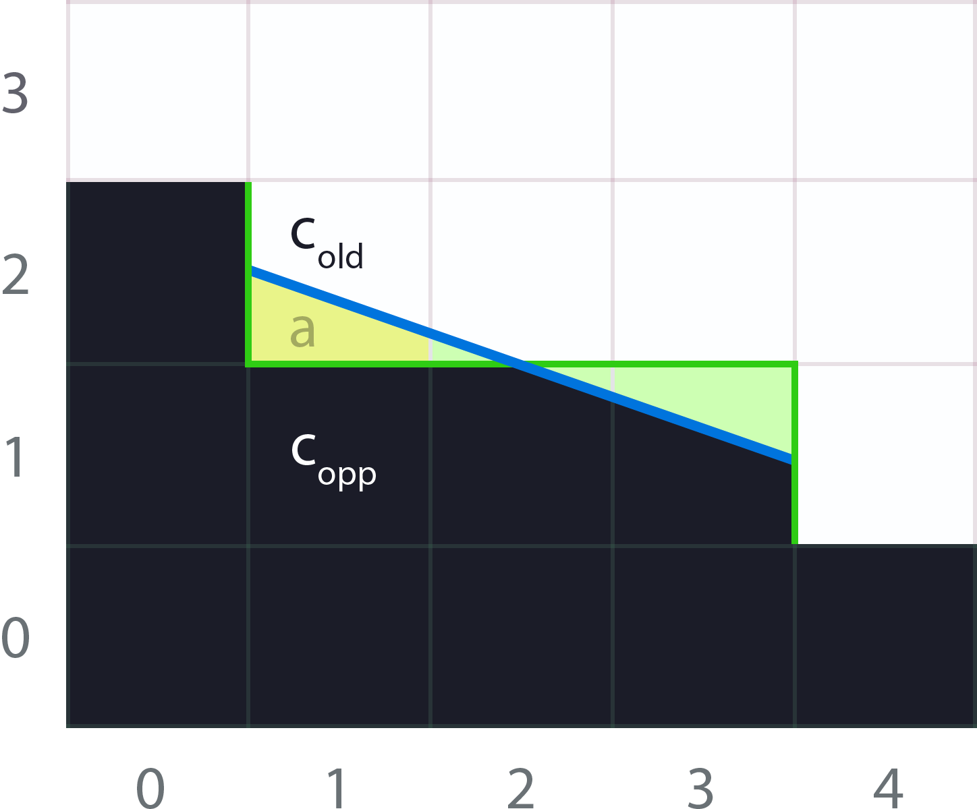
Neighborhood Blending 3rd Pass
We blend with the neighborhood using the areas calculated in previous pass
c_{new} = (1 - a) · c_{old} + a · c_{opp}
3rd
Notes:
Finally, we want to blend pixel on edges using the areas calculated on the previous pass.
For example, for the case of the pixel c_old, we got the area a from the edge on the bottom.
The blending required [click] is similar to 1D bilinear filtering.

Slide 55
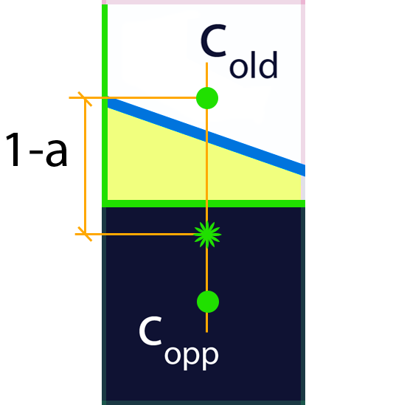
Neighborhood Blending 3rd Pass
We leverage bilinear filtering (yet again):
c_{new} = (1 - a) · c_{old} + a · c_{opp}
3rd
Notes:
So, we again leverage bilinear filtering, using it to implement the blending equation.

Slide 56
Neighborhood Blending 3rd Pass
Shader code (I):
float4 NeighborhoodBlendingPS(float4 position : SV_POSITION,
float2 texcoord : TEXCOORD0) : SV_TARGET {
// Fetch the blending weights for current pixel:
float4 topLeft = blendTex.SampleLevel(PointSampler, texcoord, 0);
float bottom = blendTex.SampleLevel(PointSampler, texcoord, 0, int2(0, 1)).g;
float right = blendTex.SampleLevel(PointSampler, texcoord, 0, int2(1, 0)).a;
float4 a = float4(topLeft.r, bottom, topLeft.b, right);
// Up to 4 lines can be crossing a pixel (one in each edge). So, we perform
// a weighted average, where the weight of each line is 'a' cubed, which
// favors blending and works well in practice.
float4 w = a * a * a;
3rd
Notes:
Here [click], we can see how we fetch the areas of the four possible lines.

Slide 57
Neighborhood Blending 3rd Pass
Shader code (II):
// There is some blending weight with a value greater than 0.0?
float sum = dot(w, 1.0);
[branch]
if (sum > 0.0) {
float4 o = a * PIXEL_SIZE.yyxx;
float4 color = 0.0;
// Add the contributions of the possible 4 lines that can cross this
// pixel:
color = mad(colorTex.SampleLevel(LinearSampler, texcoord + float2( 0.0, -o.r), 0), w.r, color);
color = mad(colorTex.SampleLevel(LinearSampler, texcoord + float2( 0.0, o.g), 0), w.g, color);
color = mad(colorTex.SampleLevel(LinearSampler, texcoord + float2(-o.b, 0.0), 0), w.b, color);
color = mad(colorTex.SampleLevel(LinearSampler, texcoord + float2( o.a, 0.0), 0), w.a, color);
// Normalize the resulting color and we are finished!
return color / sum;
} else {
return colorTex.SampleLevel(LinearSampler, texcoord, 0);
}
}
3rd
Notes:
And here [click], we blend with the neighbors, averaging the result of the four possible lines that can cross the pixel.

Slide 58
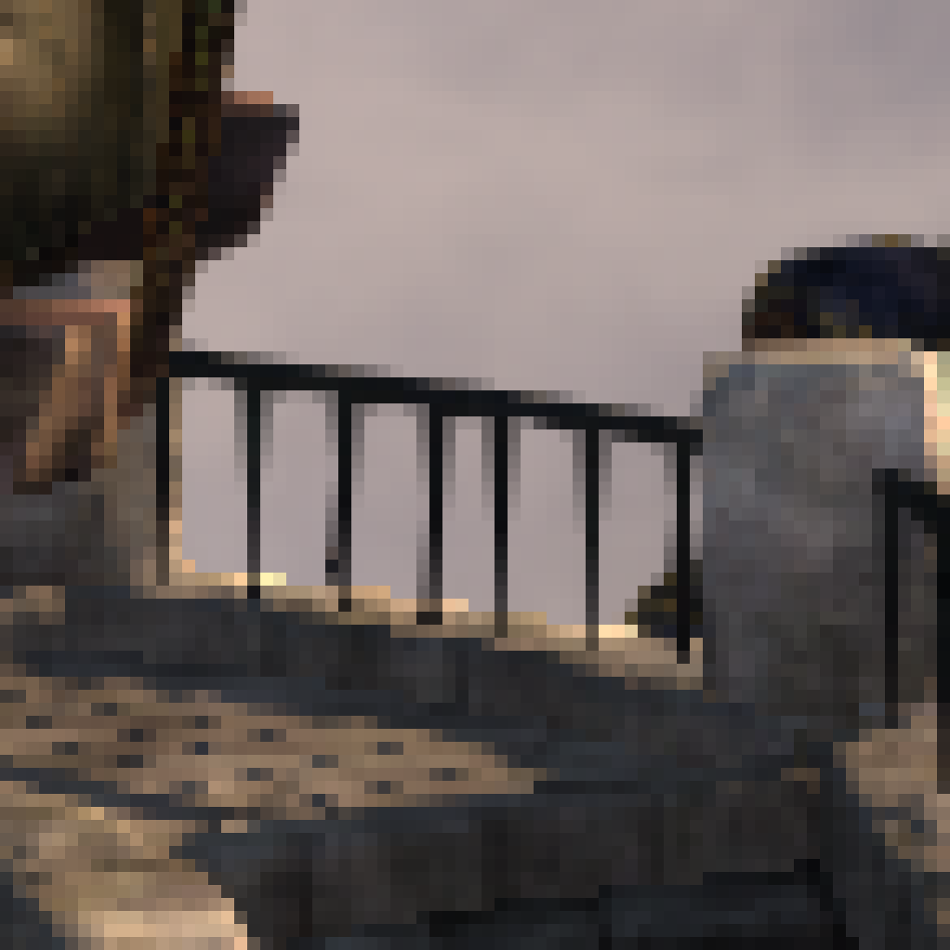
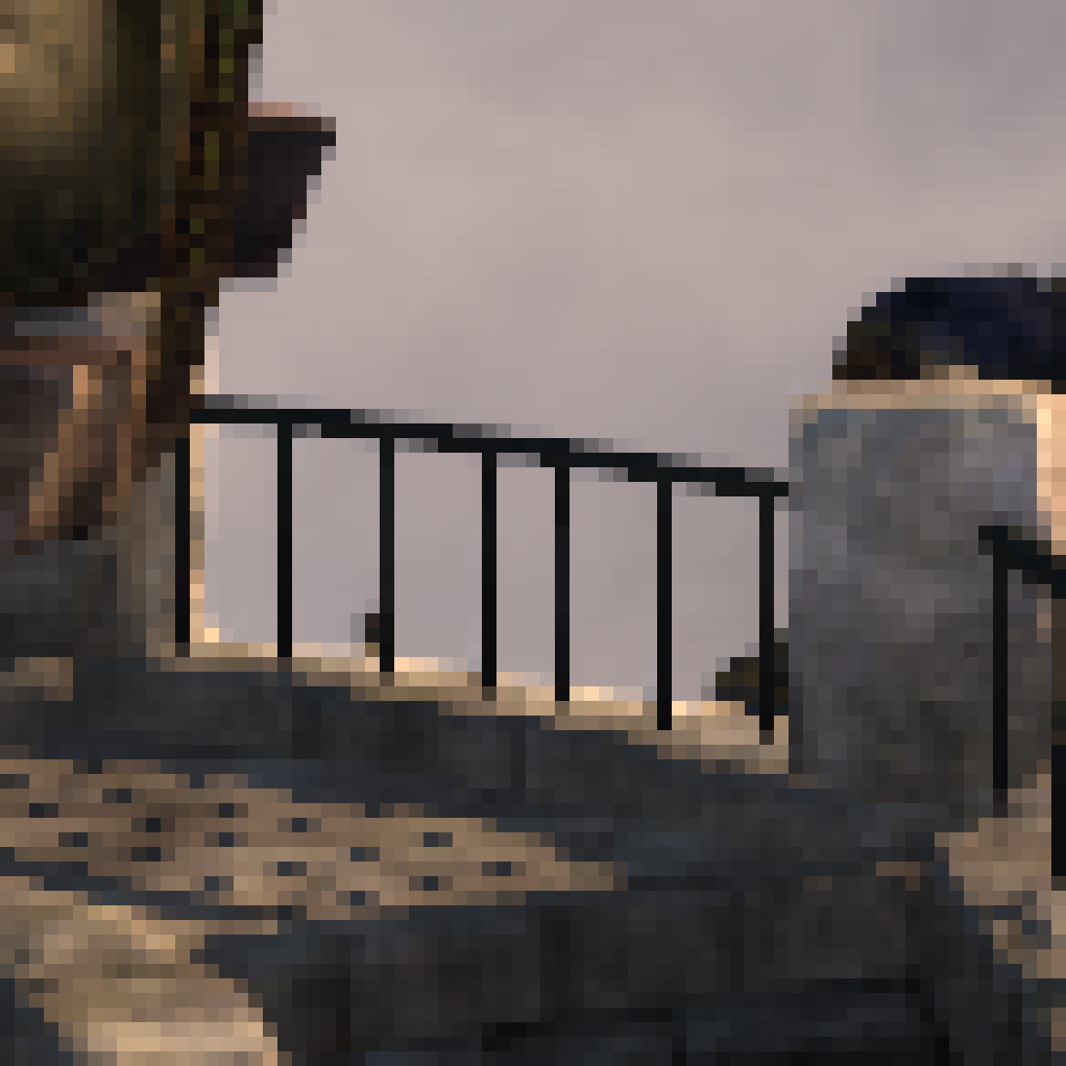
SRGB and linear blending
Blending should be done in linear space
3rd
MLAA
(Gamma Blend)
MSAA 8x
Notes:
For the most accurate results, this blending should be done in linear space.
[back and forth] You can see that the differences between gamma and linear are subtle… yet apparent.
Using SRGB buffers and DirectX 10 will ensure blending is done in linear space.

Slide 59

SRGB and linear blending
Blending should be done in linear space.
3rd
MLAA
(Linear Blend)
MSAA 8x
Notes:
For the most accurate results, this blending should be done in linear space.
[back and forth] You can see that the differences between gamma and linear are subtle… yet apparent.
Using SRGB buffers and DirectX 10 will ensure blending is done in linear space.

Slide 60
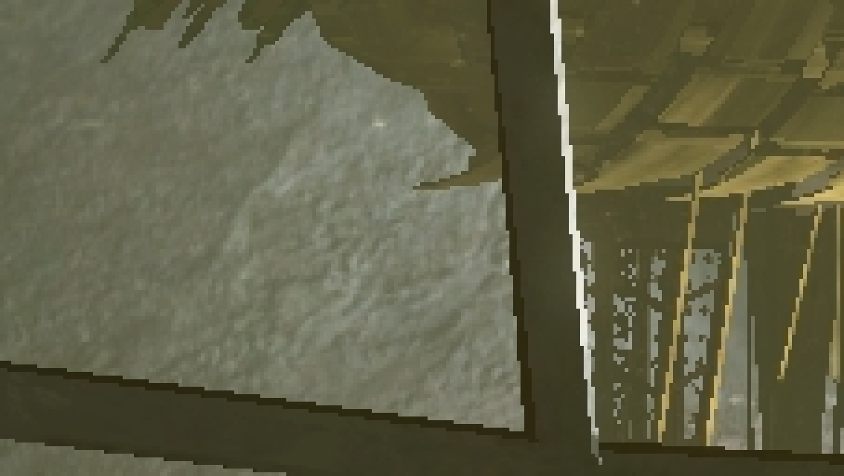
Notes:
I encourage you to visit our page for looking at the results, but nevertheless, I’m going to show some of them.
Here you have the first one.

Slide 61

Notes:
Where you can appreciate the accuracy of color edge detection.

Slide 63
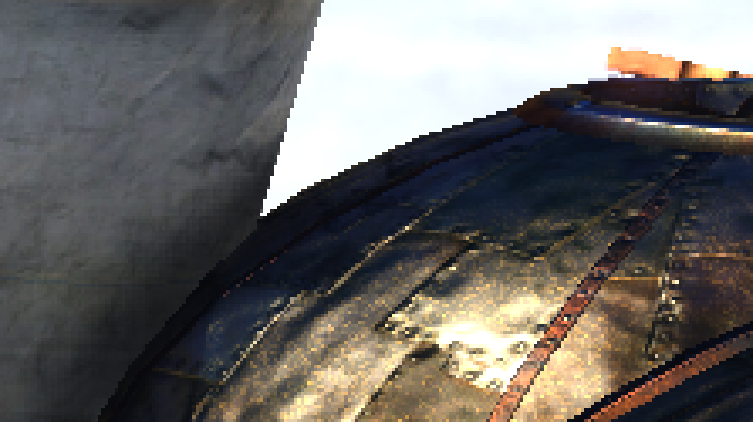
Notes:
And here, an interesting image from Unigine.
As you can see [back and forth], some texture detail is lost when using color edge detection.

Slide 64

Notes:
And here, an interesting image from Unigine.
As you can see [back and forth], some texture detail is lost when using color edge detection.

Slide 66
Notes:
On the other hand, when using depth based edge detection…
The texture detail is perfectly preserved.

Slide 67

Notes:
On the other hand, when using depth based edge detection…
The texture detail is perfectly preserved.

Slide 68
Notes:
However, some zones with little depth deltas will not be antialiased.
How to combine the best of both worlds, will be covered by Tobias later on.

Slide 69
Performance
0.28ms@720 on a GeForce GTX 470
0.37ms@720 if Gather4 is not used
Assasin's Creed | 0,368 | 0,10
Bioshock | 0,352 | 0,12
Crysis | 0,348 | 0,12
Dead Space | 0,312 | 0,12
Devil May Cry 4 | 0,256 | 0,05
GTA IV | 0,234 | 0,01
Modern Warfare 2 | 0,248 | 0,02
NFS Shift | 0,26 | 0,04
Split / Second | 0,276 | 0,04
S.T.A.L.K.E.R. | 0,29 | 0,04
Grand Average | 0,2944 | 0,08
Measured with screen captures
Notes:
So, this is all good, it’s really fast, it works fine [click], and this technique is already been used in several games.
However we have much better news, we have just made public a technical report about…

Slide 70
SMAA
Subpixel Morphological Antialiasing
Notes:
What we called Subpixel Morphological Antialiasing.

Slide 71

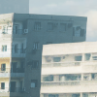
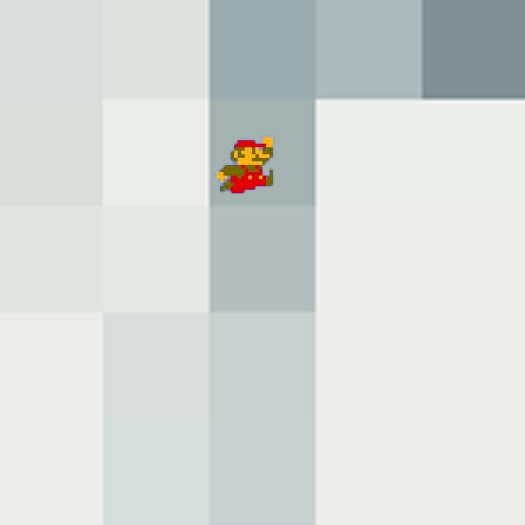
SMAA:
Subpixel Morphological Antialiasing
Temporal AA
Great
subpixel features!
MLAA
Great gradrients!
MSAA
Great subpixel features!
Notes:
Some months ago we were thinking:
Morphological Antialiasing is good [click]
Temporal Antialiasing is also good thing [click]
And multisampling is very good [click]
So, why not combine them into a single technique?

Slide 72
SMAA:
Subpixel Morphological Antialiasing
Temporal AA
Good
subpixel features!
MLAA
Great
gradients!
MSAA
Great subpixel features!
Notes:
…
But, well… it’s not as easy as it sounds.

Slide 73



SMAA:
Subpixel Morphological Antialiasing
MLAA
Post-Resolve
MLAA
MSAA 2x
Notes:
If you try to apply morphological antialiasing after resolving, it won’t be able to generate proper gradients, given the edges are now smoother and harder to detect.

Slide 74



SMAA:
Subpixel Morphological Antialiasing
MLAA
Pre-Resolve
MLAA
MSAA 8x
Notes:
And if you try to apply it before resolving, it’s an improvement over MLAA but it is still not that good, as there is too much blur.

Slide 75

SMAA:
Subpixel Morphological Antialiasing
Notes:
I won’t enter in details, but by offseting the revectorizations to match the subpixel positions, we managed to obtain much better results.

Slide 76

Notes:
We encourage you to download the technical report for a very exhaustive details.

Slide 77



SMAA:
Subpixel Morphological Antialiasing
Better fallbacks: everything is processed
  Zones with low contrast are antialiased by multi/supersampling
MLAA
SMAA S2x
SSAA 16x
Notes:
Being composed of three components, when one of them fails, the other two serve as fallback.
In this example, we can see how low contrast zones, usually ignored by morpholohical approches are handled by our spatial multisampling component.

Slide 78



SMAA:
Subpixel Morphological Antialiasing
Improves pattern handling
  Diagonals
MLAA
SMAA S2x
SSAA 16x
Notes:
We also achieve better handling of diagonals…

Slide 79





SMAA:
Subpixel Morphological Antialiasing
Improves pattern handling
  Sharp geometric features detection (good for text!)
(Insane: 256 patterns!)
Extended Area Texture
Input
MLAA
SMAA 1x
Notes:
and improved sharp geometric features, which allows to avoid the general roundness introduced by MLAA.
It also enables better text handling, by the cost of just two additional memory accesses.

Slide 80


SMAA:
Subpixel Morphological Antialiasing
Accurate searches
Notes:
Our simplified search scheme, while very fast, sometimes introduced artifacts in form of dithering.
This is, due to the fact that, as we sample in the middle between pixels [click], the last step is ambiguous.

Slide 81
SMAA:
Subpixel Morphological Antialiasing
Accurate searches
Notes:
So by sampling at different offsets in the x and y directions [click], we stop at the appropriate moment without incurring into any additional overhead.

Slide 82

SMAA:
Subpixel Morphological Antialiasing
Take neighborhood lumas into account
Notes:
Another feature we introduced is what we call local contrast awareness.
A big drawback of MLAA approaches is that they usually consider edges binary: they are either on or off.
Sometimes this can be an issue, because the actual strength of an edge is important.
For example, in this image we can see there are gradients in the silhouette of this object…

Slide 83
SMAA:
Subpixel Morphological Antialiasing
Take neighborhood lumas into account
Notes:
…which confuse MLAA’s search scheme [click], as it will see crossing edges that will make it stop earlier than desired.

Slide 84
SMAA:
Subpixel Morphological Antialiasing
Take neighborhood lumas into account
Notes:
However, perceptually we ignore these crossing edges because the contrast with the white background is much, much, higher.
So, what we did is to mimic our visual system and ignore edges which have low contrast with respect to the neighbors.

Slide 85

What’s under the hood
High Quality
  16$×$gradients (or more!)
  Noise proof → Temporally Stable
  Sharpness preservation
What’s under the hood
  The fast and accurate distance searches
  The local contrast awareness
  Specific patterns tuning
  Calculating the four possible lines that can cross a pixel, and smartly average them
Notes:
We believe the key component of our technique is the heuristics we are using for determining which is the best pattern revectorization for a pixel, and to stick with it over time.

Slide 86
SMAA:
Subpixel Morphological Antialiasing
Modular
  SMAA 1x improved pattern handling
  SMAA T2x 1x + temporal supersampling
  SMAA S2x 1x + spatial multisampling
  SMAA 4x 1x + 2x temporal supersampling + 2x spatial multisampling
Performance of SMAA 4x (on a GTX 580)
  1.06 ms @1080p
  0.5 ms@720p both not taking into account 2x render overhead
Notes:
The technique is modular, so you can turn on features selectively, easily adapting it to the available budget.
In fact, most of the improvements just add a few lines to our current MLAA shader.
So, upgrading to SMAA is going to be a rather easy task.

Slide 87
SMAA:
Subpixel Morphological Antialiasing
Modular
  SMAA 1x improved pattern handling
  SMAA T2x 1x + temporal supersampling
  SMAA S2x 1x + spatial multisampling
  SMAA 4x 1x + 2x temporal supersampling + 2x spatial multisampling
Performance of SMAA 4x (on a GTX 580)
  1.06 ms @1080p
  0.5 ms@720p both not taking into account 2x render overhead
Notes:
And finally, the performance of the highest quality profile, runs in 1 millisecond for a 720p buffer.

Slide 88

Visit us!
Visit our project pages:
  http://www.iryoku.com/mlaa
  http://www.iryoku.com/smaa
SMAA technical paper:
  http://www.iryoku.com/papers/SMAA-Enhanced-Subpixel-Morphological-Antialiasing.pdf
Github page:
  https://github.com/iryoku/smaa/
Thanks to:
  Stephen Hill
  Jean-Francois St-Amour
  Naty Hoffman
  Natasha Tatarchuk
  Johan Andersson
Notes:
Sorry that we didn’t give a detailed description of SMAA, but you have the technical report online, and I will be posting about each feature on my blog in the next weeks =]
My colleague Pete from Double Fine, will continue with the presentation of his Hybrid MLAA approach.
Thank you for your attention, and do not forget to visit us :-)

