Slide 1
Filtering Approaches for Real-Time Anti-Aliasing
http://www.iryoku.com/aacourse/

Slide 2
Filtering Approaches for Real-Time Anti-Aliasing Geometry Buffer Anti-Aliasing (GBAA)
Emil Persson
Avalanche Studios
emil.persson@avalanchestudios.se
http://www.humus.name/

Slide 3
Basic idea
MLAA and friends recover edges from backbuffer (and optionally depth-buffer)
Idea:
Game engine knows where the edges are.
Let’s use that!

Slide 4
First Attempt - GPAA
Overdraw edges in final image
Determine major direction (horizontal/vertical)
Compute coverage
Blend with suitable neighbor
Optimize with texture filter
Pre-process scene geometry
Extract relevant edges
Notes:
Pre-process eliminates internal edges in a surface and removes duplicates from shared edges.
Line equations are computed in screen-space and passed to pixel shader.

Slide 5
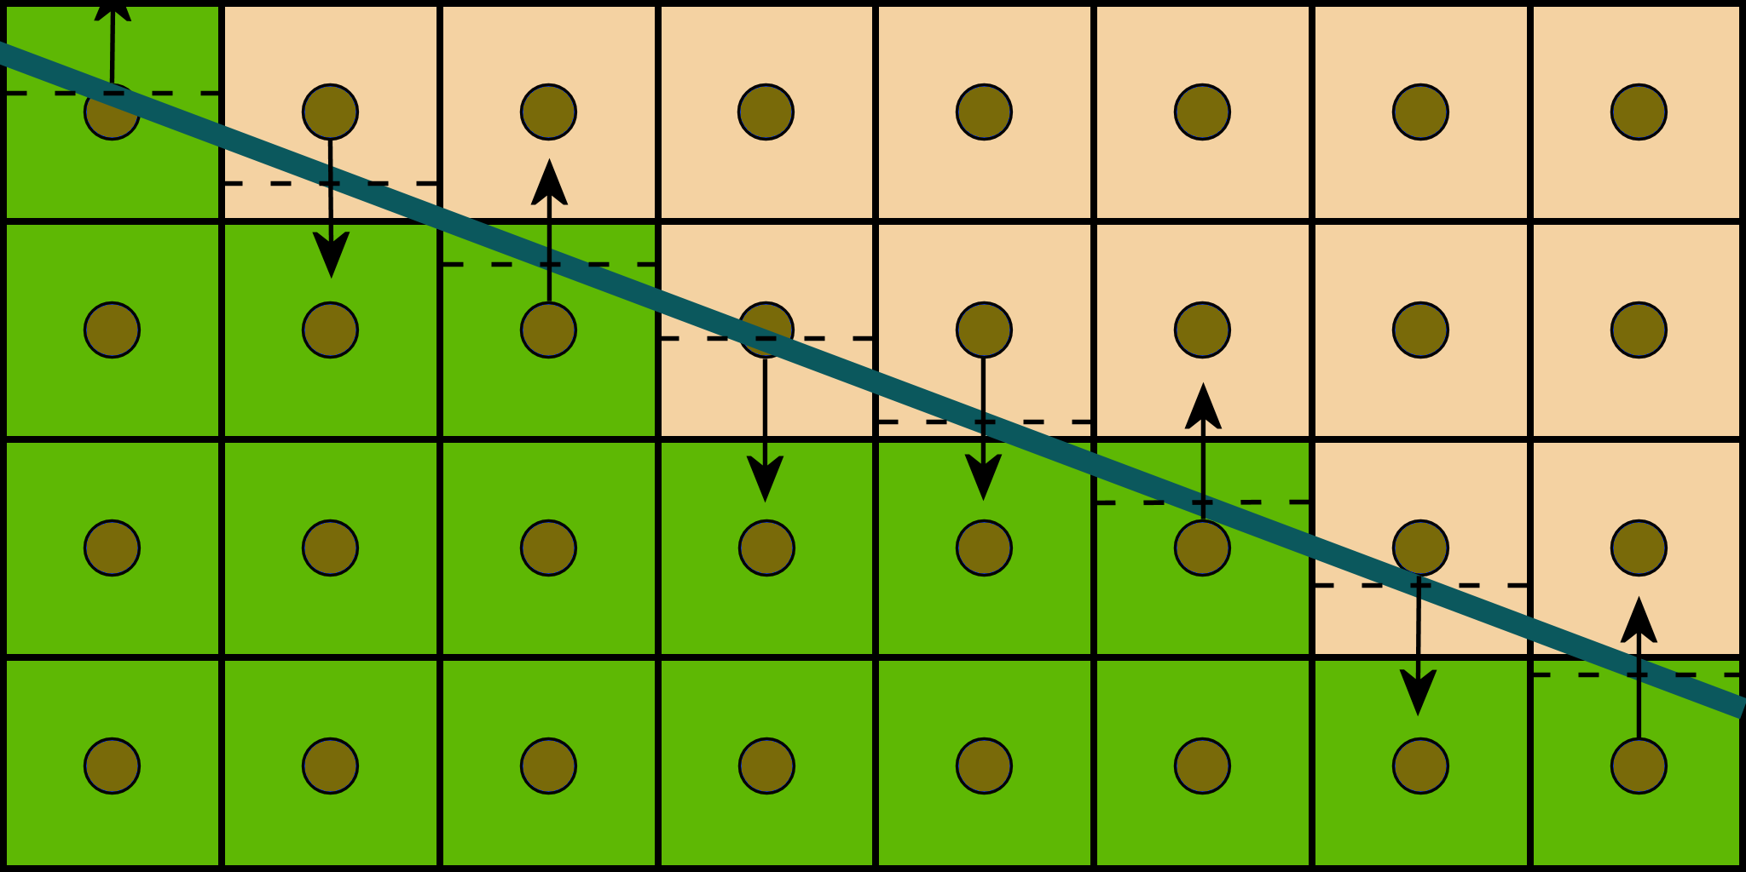
GPAA – Shader
// Compute the difference between geometric line and sample position
float diff = dot(In.KMF.xy, In.Position.xy) + In.KMF.z;
// Compute the coverage of the neighboring surface
float coverage = 0.5f - abs(diff);
float2 offset = 0;
if (coverage > 0) {
// Select direction to sample a neighbor pixel
float off = (diff >= 0)? 1 : -1;
if (asuint(In.KMF.w))
offset.y = off;
else
offset.x = off;
}
// Blend pixel with neighbor pixel using texture filtering and shifting the coordinate appropriately.
return BackBuffer.Sample(Filter, (In.Position.xy + coverage * offset.xy) * PixelSize);
Notes:
In.KMF contains line equation for either horizontal or vertical direction. Direction flag is stored in w.
Sampling direction is selected based on which side the pixel center the line cuts the pixel.
Coverage is computed from distance.

Slide 6
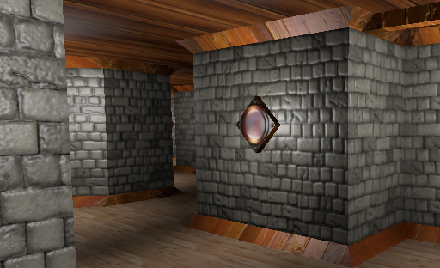
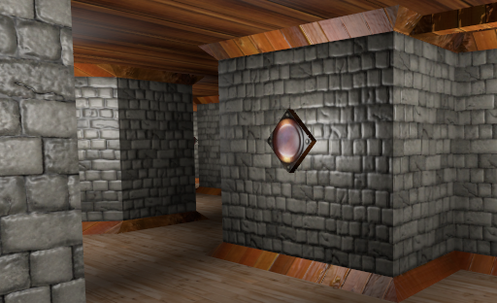
GPAA - Results

Slide 7
GPAA - Conclusions
Very high quality
Very accurate coverage
Excels on near horizontal/vertical case
Temporally stable
Edge extraction step
Inconvenient
Increased memory consumption
Line rasterization
Not ideal for performance
Scaling issues with increasing geometric density
Notes:
Demo with source available for download at http://www.humus.name

Slide 8
Second Attempt - GBAA
Geometry info stored to render-target in main pass
No geometry pre-processing
No line rasterization
Small constant memory addition
Fullscreen ”resolve” pass
Fixed cost
Notes:
Geometry Buffer is fullscreen, two channels, signed format. Could pack into single channel if necessary (one bit stores flag for horizontal/vertical)

Slide 9
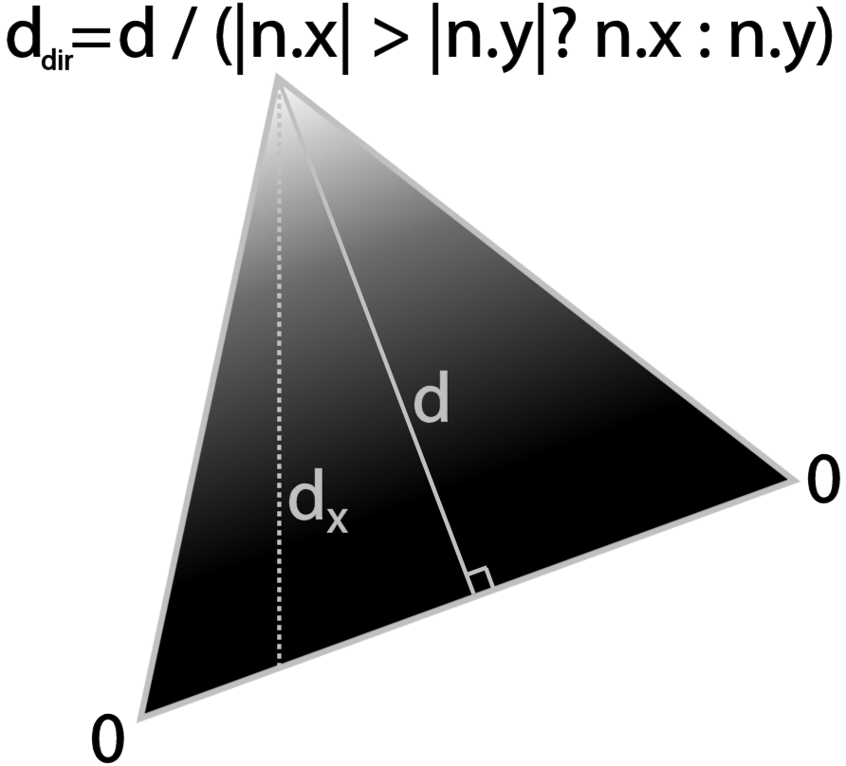
GBAA
Geometry shader passes down geometry info
Stores distance to edge in the major direction
Use interpolator instead of line equation math
Using noperspective keyword
Pixel shader selects closest edge
Notes:
The two vertices on the edge are naturally of zero distance to that edge.
The top vertex is assigned the vertical distance because the edge is horizontal.
The perpendicular distance (d) is computed first, then scaled by a factor to become the vertical distance (dx).

Slide 10
GBAA - Resolve
For each pixel, check buffer for intersecting edge
If distance is less than half pixel, we have one.
Select neighbor, compute coverage and blend.
Otherwise, leave pixel unchanged.

Slide 11
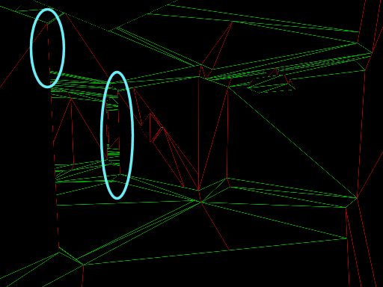
GBAA - Resolve
Problem: Gaps at silhouette edges
Notes:
These gaps occur because only one side of the edge has relevant geometry information. The background surface does not know about the foreground geometry. The foreground will blend properly towards the edge, but the background will not blend at all since it has no indication of an edge passing through. This results in visible gaps in the antialiasing along silhouette edges. Edges between adjacent triangles are not affected because both sides are aware of the edge.

Slide 12
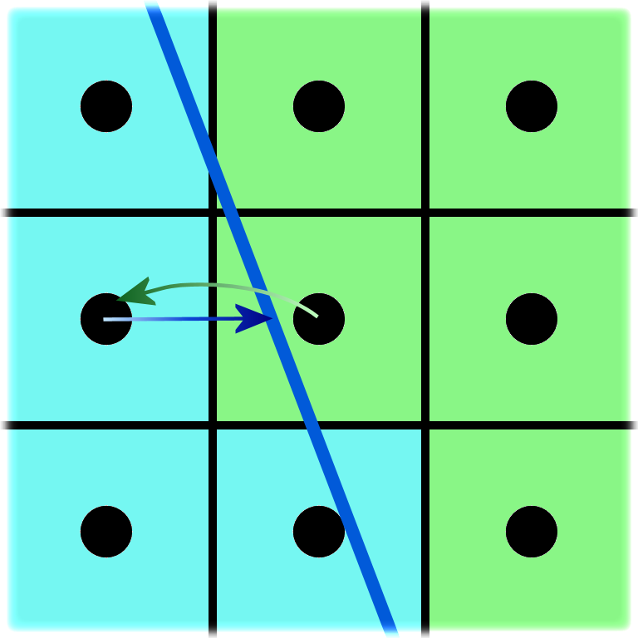
GBAA - Resolve
Solution
Search immediate neighbors for their closest edge
Use edge matching current pixel, if any.
Left: offset.x in [0.5, 1.0]
Right: offset.x in [-1.0, -0.5]
Up: offset.y in [0.5, 1.0]
Down: offset.y in [-1.0, -0.5]
Notes:
We only need to check the component that can point towards us. For left/right check whether the x-component match this pixel, for up/down check y-component. If the neighbor’s distance value is such that it would cut this pixel we use this edge information.
In this illustration the left pixel hold relevant edge info. The value is perhaps 0.8, which is more than 0.5 (pixel’s left edge) and less than 1.0 (pixel center). This gives us a distance of 0.8 – 1.0 = -0.2, i.e. edge cuts through 0.2 pixel units to the left of the pixel center.
Note that in this illustration the down pixel also points to the right, thus it is of no use, because it has to point up to be useful. Right and up belong to the same surface and hold not useful information in this situation either.

Slide 13
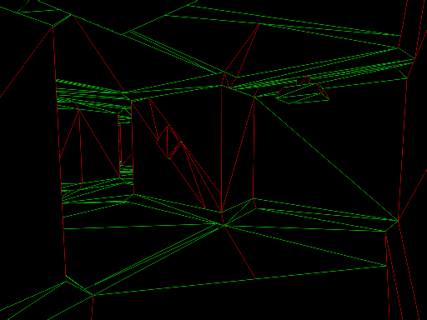
GBAA - Resolve
Edges recovered!

Slide 14
GBAA - Shader
float2 offset = GeometryBuffer.Sample(Point, In.TexCoord).xy;
// Check if edge intersects pixel, otherwise search neighborhood
[flatten] if (max(abs(offset.x), abs(offset.y)) > 0.5f) {
offset = 0.0f;
float2 offset0 = GeometryBuffer.Sample(Point, In.TexCoord, int2(-1, 0)).xy;
float2 offset1 = GeometryBuffer.Sample(Point, In.TexCoord, int2( 1, 0)).xy;
float2 offset2 = GeometryBuffer.Sample(Point, In.TexCoord, int2( 0, -1)).xy;
float2 offset3 = GeometryBuffer.Sample(Point, In.TexCoord, int2( 0, 1)).xy;
if (abs(offset0.x - 0.75f) < 0.25f) offset = offset0.xy + float2(-1, 0);
if (abs(offset1.x + 0.75f) < 0.25f) offset = offset1.xy + float2( 1, 0);
if (abs(offset2.y - 0.75f) < 0.25f) offset = offset2.xy + float2( 0, -1);
if (abs(offset3.y + 0.75f) < 0.25f) offset = offset3.xy + float2( 0, 1);
}
float2 off = (offset >= float2(0, 0))? float2(0.5f, 0.5f) : float2(-0.5f, -0.5f);
offset = offset? off - offset : offset;
// Blend pixel with neighbor pixel using texture filtering and shifting the coordinate appropriately.
return BackBuffer.Sample(Linear, In.TexCoord + offset.xy * PixelSize);

Slide 15
GBAA – Alpha test
GBAA can AA any edge, if distance can be computed/estimated
Alpha-tested edges, estimate with gradients
float dx = ddx(alpha);
float dy = ddy(alpha);
bool major_alpha_dir = abs(dx) > abs(dy);
float alpha_dist = -alpha / (major_alpha_dir? dx : dy);
Internal shader edges
Parallax Occlusion Mapping
Notes:
Alpha-test can be better estimated by taking gradients of texture coordinate and sample texture left/right/up/down. This is more costly though, and the above works good enough in practice.

Slide 16
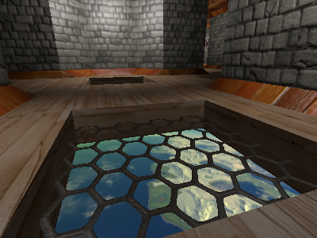
GBAA – Results
Notes:
Results as good as GPAA, but also AA on alpha-tested surfaces.

Slide 17
GBAA - Performance
Resolve pass:
GPU: Radeon HD 5870
1280 x 720 | 0.09 ms
1920 x 1080 | 0.18 ms
2560 x 1600 | 0.36 ms
Notes:
Resolve pass is cheap and has fairly constant cost. I used clip() to reduce writes to backbuffer, which improved performance somewhat. This may not be an optimization for dense geometry though.
Note that these numbers are the resolve pass only. This technique also incur a cost during main scene rendering, which is content dependent and may vary from scene to scene.

Slide 18
Future work
DX9 / console
Internal edges
Multiple edges per pixel
Blend with multiple neighbors
DX11 with OIT
Blend with background instead of neighbor
Notes:
Current implementation depends on geometry shader, DX10. It is possible to implement in DX9 though, but would be more costly in terms of memory. Ways around this would be an interesting research topic.
Internal edges should not be antialiased. Current implementation does. It appears to do no serious harm, but ideally should be avoided.
Corners and T-junctions can sometimes cause minor artifacts. Using all edges and blend more neighbors could probably clean up these cases.
Blending down in the depth is more correct than blending to the side. With order-independent-translucency becoming more practical, this may be the way we do post-AA in the future.

Slide 19
Conclusion
Very high quality anti-aliasing
Low fixed memory cost
Cheap resolve pass
Varying cost in main rendering
Still researching
Check www.humus.name for the latest results
Notes:
GBAA demo available for download at www.humus.name.
Avalanche Studios is hiring for Stockholm and New York.
Next up is Tiago Sousa from Crytek who will talk about “Anti-Aliasing Methods in CryENGINE 3”

