Slide 1
Filtering Approaches for Real-Time Anti-Aliasing
http://www.iryoku.com/aacourse/

Slide 2
Anti-Aliasing From a Different Perspective
Dmitry Andreev (AND)
dandreev@LucasArts.com
Notes:
Final version with in-depth commentaries is available at http://and.intercon.ru/

Slide 3
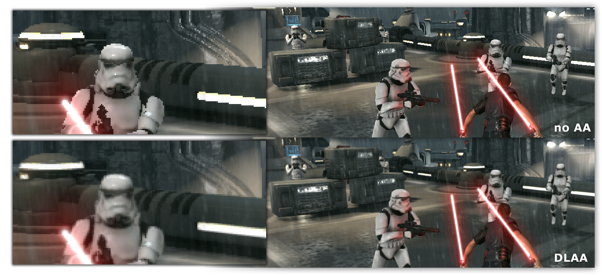
Directionally Localized Anti-Aliasing

Slide 4
Agenda
Aliasing & Anti-Aliasing
Alternative Solutions
Exploration
DLAA
PS3 & X360

Slide 5
The Idea Is ...
Blur Edges Along Their Directions

Slide 6
Blurred. Done !

Slide 7
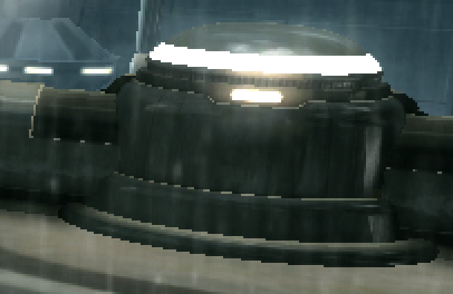
Aliasing
Signal Processing
Indistinguishable signals when sampled
Artifact of reconstruction
Graphics
Pixel "noise"
Edge jaggies

Slide 8
Anti-Aliasing I
Reduce Higher-Frequencies
Oversample And "Blur"
Temporal in audio
Spatial in optics
No Perfect Filter Exists
Sampling theory
Sharp (aliased) vs soft (anti-aliased)

Slide 9
Anti-Aliasing II
Texture
Mip-mapping
Shading
Specular, rim lighting
Avoid manually
Geometry Edges
Multi-sampling (MSAA)
Custom solutions

Slide 10
MSAA
Good Quality
Partial Super Sampling
At least depth
Deferred Rendering Unfriendly
Costly On Consoles
Directly and indirectly

Slide 11
Alternatives
Screen-Space Filtering
Perception based
Hide jaggies
Morphological AA (MLAA)
Temporal (Crysis 2, Halo)
Edge-Based AA

Slide 12
MLAA
Morphological Anti-Aliasing (Intel)
Reconstruct original geometry
Re-blend neighbors
CPU Friendly
The Saboteur
GoW3 (4ms / 5 SPUs)
XBox360 GPU (> 3.7 ms)

Slide 13
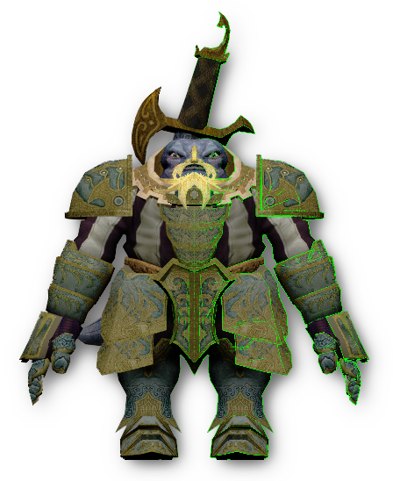
Edge-Based
XBox360 SDK Sample
Render one-pixel wide polygons
Texcoord as pixel coverage
Re-blend neighbors

Slide 14
Could Not Use
MLAA
Unstable
Tough on X360
Edge-Based
Extra GPU cost on PS3
Temporal
Dynamic resolution adjustment in TFU2
Motion vs resolution

Slide 15
"Ideal" AA Filter
Multi-Platform
GPU, SPU
Reliable in production
Temporally Stable
Perception Based
Hide jaggies
Good Quality For Low Cost

Slide 16
What If …
Create Pixel Coverage-Like Look

Slide 17
Fresnel Term Based
( N·V )^{n}
Re-Blend
Curved Surfaces Only
Hard To Control

Slide 18
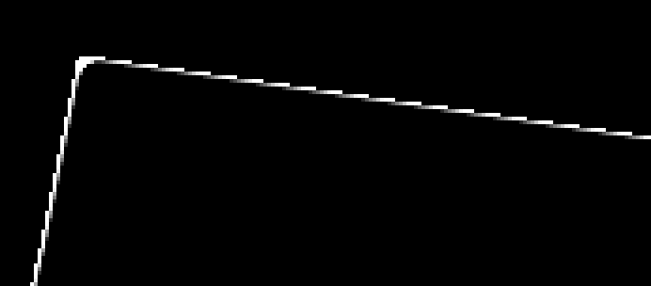
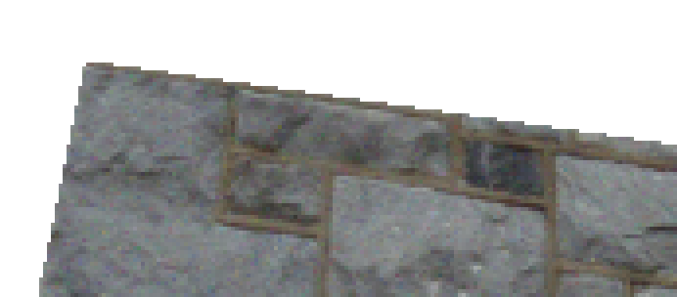
Depth Based Gradients
Find Edge Gradients
Depth box-blur
Adjust levels locally
Re-Blend
Flat Surfaces

Slide 19
Depth Re-Sampling
Render Alternative Depth
Rotated 2nd z-pre pass
Or 4x MSAA for depth
Compute Pixel Coverage
Remap depth value
Re-Blend

Slide 20
Observation
no AA super sampled blurred vertically

Slide 21
DLAA Prototyping I
Photoshop
Layers vs Pixels
Hard to do complex things
Easy to implement IF works :)
Filter / Other / Custom
Basic 5x5 convolution
Blurs, Edges, etc...

Slide 22
DLAA Prototyping II
Blur Vertically
 |  | 1
 |  | 1
 |  | 1
 |  | 1
 |  | 1

Slide 23
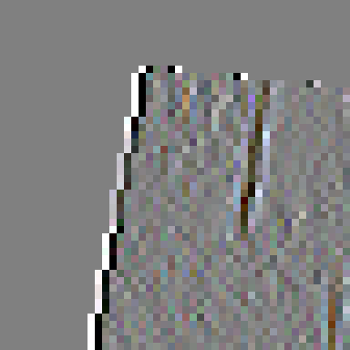
DLAA Prototyping III
Blur Vertically
Find Vertical Edges
 | -1 | 2 | -1

Slide 24
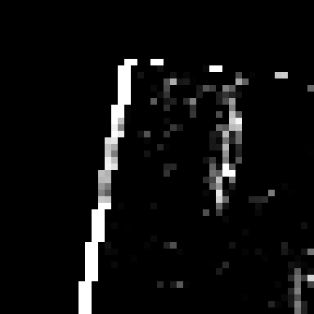
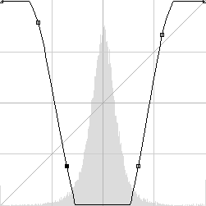
DLAA Prototyping IV
Blur Vertically
Find Vertical Edges
Build Edge Mask
saturate( abs( x ) · a – b )

Slide 25
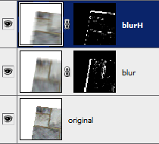
DLAA Prototyping V
Blur Vertically
Find Vertical Edges
Build Edge Mask
saturate( abs( x ) · a – b )
Blend With Original Layer
Same Horizontally

Slide 26
Short Edges Only

Slide 27
Two Cases
5-Pixel Wide 16-Pixel Wide

Slide 28
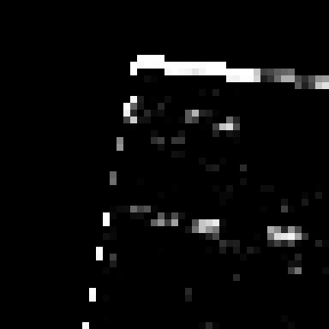
Long Edge Detection I
Take High-Pass Mask

Slide 29
Long Edge Detection II
Take High-Pass Mask
Blur

Slide 30
Long Edge Detection III
Take High-Pass Mask
Blur
Adjust Contrast

Slide 31
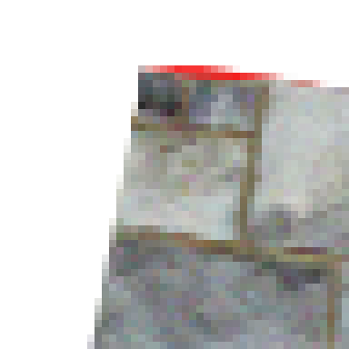
Long Edge Detection IV
Take High-Pass Mask
Blur
Adjust Contrast
Apply Long-Edge Filter
Where it's needed

Slide 32
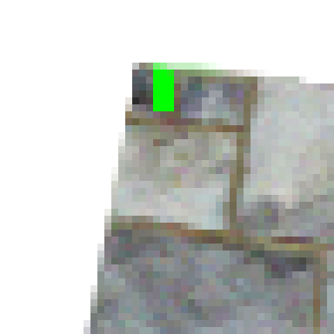
Long Edge Filtering I
Color Bleeding

Slide 33
Long Edge Filtering II
Color Bleeding
Luminosity Blending Mode
Blurred luminance As Target
Find local pixel that matches it

Slide 34
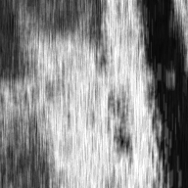
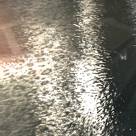
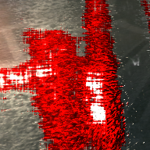
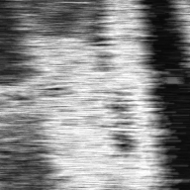
Noise Level Estimation
Exclude Noisy Regions
Have long vertical and horizontal edges
||H_{hF} – V_{hF}|| > λ
V_{hF}
hF
V_{hF}
hF
H_{hF}
H_{hF}

Slide 35
Gradient Levels Comparison
no AA
MLAA
DLAA

Slide 36
Visual Results

Slide 37
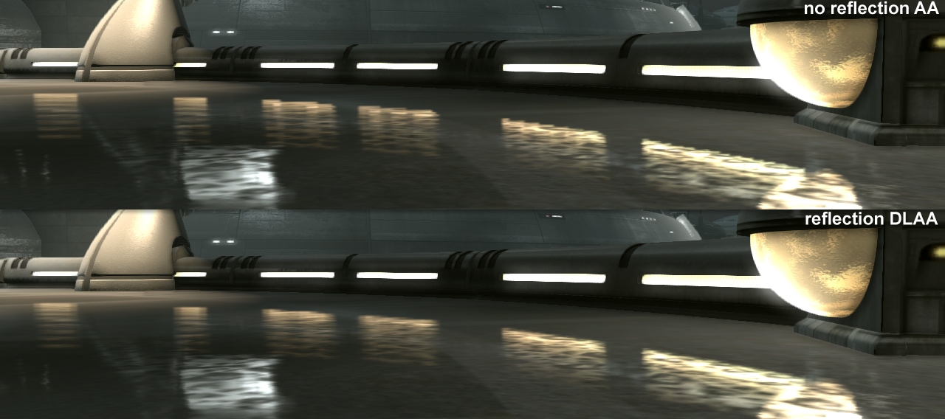
Reflections Anti-Aliasing

Slide 38
Execution Results @ 720p
XBox360 2.2 ± 0.2 ms
PlayStation3 1.6 ± 0.3 ms (5 SPUs)
Project Time
Research 8 weeks (part time)
X360 2 weeks
PS3 (SPU) > 3 weeks

Slide 39
Implementation Strategies
Execution Time
Reuse samples
Reject as much work as possible
Balance pipelines
Memory Usage
Reuse textures and buffers
Pack data by usage
Global Pipeline Optimizations

Slide 40
Work Rejection
Pre-Process
Find long edge regions
High-pass around long edges
Resolve
Process
Short edges
Short and long edges (~10-20 %)
Resolve

Slide 41
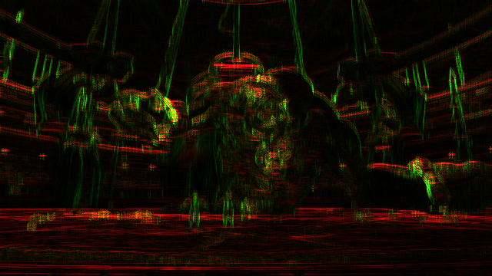
Long Edge Estimation I
Find Long Axial Edges Directly
At lower resolution (e.g. from HDR reduction)
1 | 1 | 1 | 1 | 1 | 1
-1 | -1 | -1 | -1 | -1 | -1

Slide 42
Long Edge Estimation II
Transfer Into Hi-Z (4x4 pixel blocks)
4x MSAA trick
Flip Hi-Z Test With Depth Trick
Using D3DHIZFUNC
mask
dilated Hi-Z

Slide 43
High-Pass Filter
5 Bi-Linear Samples
Around Long Edges Only
Store In Alpha
1 | 2 | 1
2 | -12 | 2
1 | 2 | 1

Slide 44
Short Edges
Low And High-Pass Filters
Reuse vertical and horizontal samples
Normalized Blending Coefficients
t_{h} = ( λ·L( edge_{h} ) – ɛ ) / L( blur_{h} )
L(x) - intensity function
Re-Blend
c = lerp( c, blur_{h}, saturate( t_{h} ) )
 |  | v₀
 |  | v₁
h₀ | h₁ | C | h₂ | h₃
 |  | v₂
 |  | v₃

Slide 45
Long Edges I
Sparse Sampling On GPU
Reuse short samples
Extra 4 bi-linear samples
Discard If Horizontal And Vertical
[branch] based on blurred high-pass
-8 |  |  |  |  |  |  |  | C |  |  |  |  |  |  |  | 8

Slide 46
Long Edges II
Find Local Pixel That Matches Blurred Intensity
blurred_{lum} = lerp( X_{lum}, Y_{lum}, t )
color = lerp( X, Y, t )
X
blurred_{lum}
Y

Slide 47
Long Edges III
Find Local Pixel That Matches Blurred Intensity
blurred_{lum} = lerp( X_{lum}, Y_{lum}, t )
color = lerp( X, Y, t )
Two Search Cases
T
C

Slide 48
Long Edges IV
Find Local Pixel That Matches Blurred Intensity
blurred_{lum} = lerp( X_{lum}, Y_{lum}, t )
color = lerp( X, Y, t )
Two Search Cases
Top and bottom neighbors
Re-Blend
Based on longEdgeMask
T
C
C
B

Slide 49
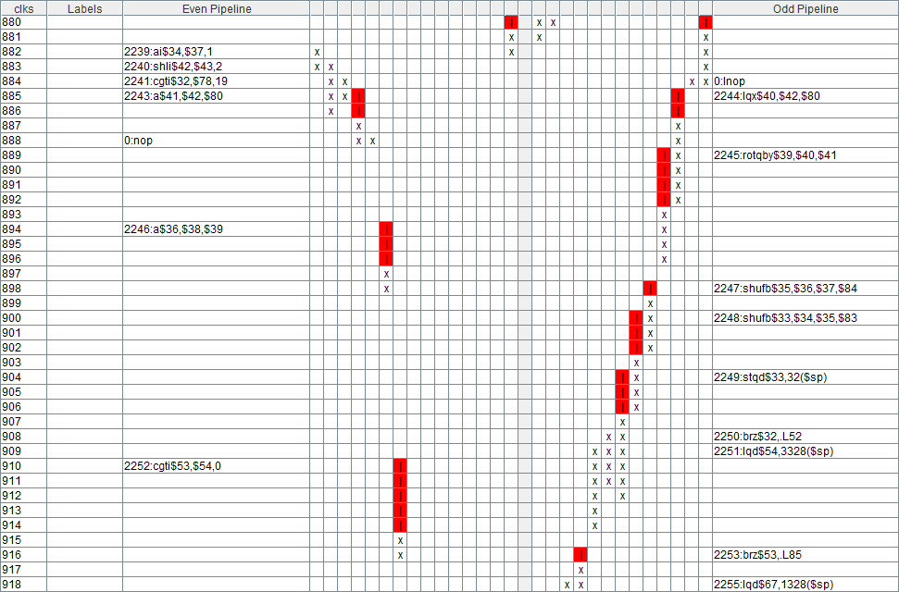
Typical SPU Code

Slide 50
SPU Post Processing
Software Pipelining
Hide latency
Balance Even And Odd Instructions
Stream Processing
Tiled RSX Surfaces
0.3 ms to copy from VRAM
Partial untiling with DMA

Slide 51
DLAA On SPUs I
No Need to Handle Overlaps
Short Edges
Byte operations → 4 RGBA pixels / clk
(1 2 1) = AVGB( AVGB( l, c ), AVGB( c, r ) )
║x – y║ = ABSDB( x, y )
Long Edges
blur( x ) = ∑f(x + dx)
blur( x + 1 ) = blur( x ) – f( x – r ) + f( x + 1 + r )

Slide 52
DLAA On SPUs II
Quick Luminance
SUMB ( G, R, G, B ) → 0.25 R + 0.5 G + 0.25 B
Quick Saturate
CFLTU x, x, 32; CUFLT x, x, 32
Quick Interpolation
r = lerp( x, y, t )
FS r, Y, X SHUFB X, x, _, _
FMA r, t, r, X SHUFB Y, y, _, _
byte in
byte out
3F | 80 | … | 00

Slide 53
Typical SPU Code

Slide 54
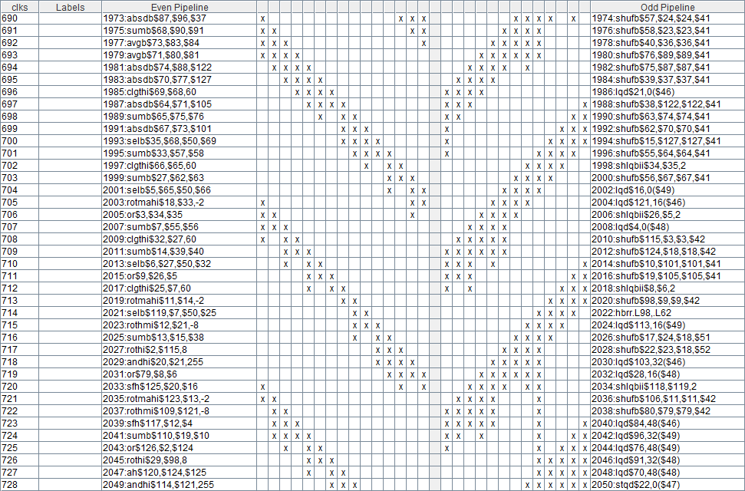
Efficient SPU Code

Slide 55
Conclusion
DLAA
XBox360 2.2 ± 0.2 ms
PlayStation3 1.6 ± 0.3 ms (5 SPUs)
End Of Console Life Cycle
Every millisecond counts
Tricks are inevitable
Different solutions & different thinking

Slide 56
Acknowledgments
Szymon Swistun
Ruslan Abdikeev
Axel Wefers
Jerome Scholler
Tom Madams
Anti-Aliasing Community

Slide 57
Thank You

Slide 58
Thank You
Questions ?
dandreev@LucasArts.com

