Slide 1
Filtering Approaches for Real-Time Anti-Aliasing
http://www.iryoku.com/aacourse/

Slide 2
Filtering Approaches for Real-Time Anti-Aliasing Anti-Aliasing Methods in CryENGINE 3
Tiago Sousa R&D Principal Graphics Engineer
Crytek
tiago@crytek.com

Slide 3
CryENGINE 3 AA Requirements
Orthogonal and general solutions
No per-platform AA solution
Play nice with HDR/Deferred techniques
Sub-pixel accuracy is important for us
Schimering was the biggest offender on Crysis 1 and 2 levels
Crysis had imensively aliased assets: alpha tested/tiny sub-pixel details
HDR makes it even worse, big range of lighting contrast/color variation
Low memory footprint
Cost less than 2 ms on low end GPUs
Every ms counts for consoles

Slide 4
MSAA Troubles for this HW Generation
Memory requirements
2x, 4x, etc
Multiplatform + Non conventional rendering [Sousa 2011]
0 support on PS3 for FP16 (for alpha blending passes)
10 MB EDRAM on x360 + Tilling + Resolves cost overhead
Alpha testing AA, requires ATOC
Tone mapping should be performed per sub-sample
Else noticeable wrong results on high contrast regions
Too expensive for older platforms
Notes:
Multitude of workarounds and added complexity
Each platform with its own solution, workarounds and optimizations
Performance cost
For current Gen, situation doens’t look promising...
Minimal G-Buffer
RGBA8 World Space BF Normals + Glossiness
Readback Z24S8 Depth + Stencil for tagging interior areas
Deferred lighting buffers
Xbox 360: 2x RGB10F resolved to RGB10A2 for performance/memory
PS3: 2x RGBA8 encoded in RGBK
PC: 2x FP16
Scene buffer
X360: RGB10F resolved to FP16 for performance
PS3: RGBA8 encoded in RGBK for opaque, FP16 for transparents
PC: FP16
X360: 28 MB; PS3: 31.5MB; PC: 49 MB at 720p, 110 MB at 1080p and so on.

Slide 5
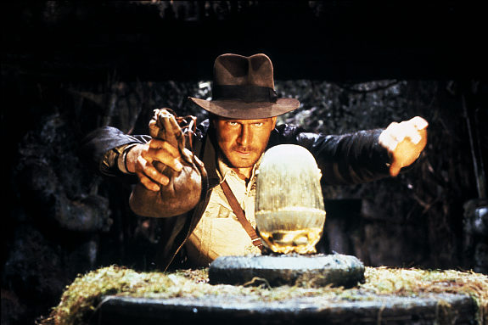
The Quest for AA Alternatives

Slide 6
Temporal Anti-Aliasing (aka Motion Blur)
Directional blur along screen space velocity vector [Green 2003]
Delta from prev/cur screen space position, per-pixel or per vertex
Image space motion blur
Main benefict: Less noticeable aliasing during movement
Pt
Pt-1
Notes:
Increasingly popularity since Crysis 1 and KZ2
Aproximated as directional blur along screen space velocity vector
Delta from prev/cur screen space position, per-pixel or per vertex
Added bonus: Great cinematic look
User for all platforms

Slide 7
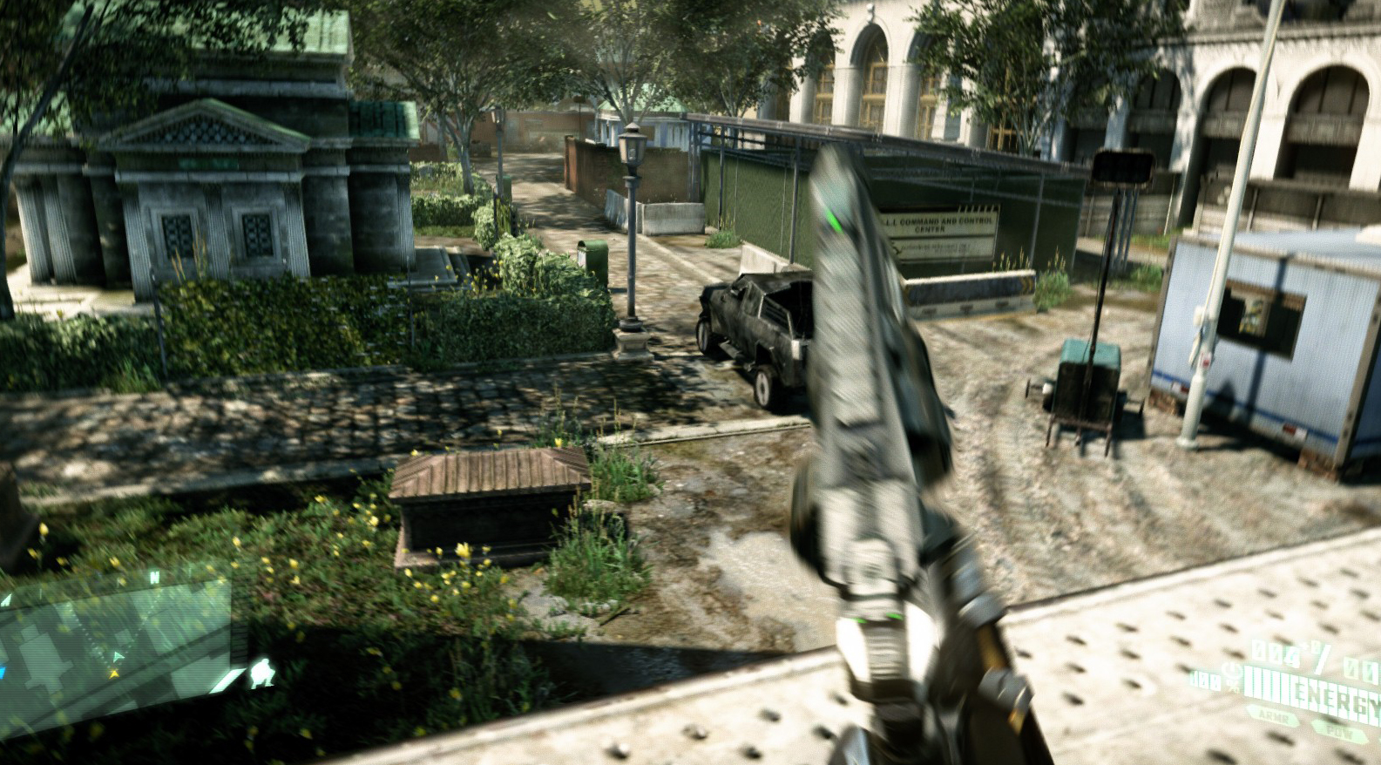
Temporal AA

Slide 8
A-Buffer SSAA [Haeberli90]
Add sub-pixel jitter to camera frustum
Brute force: Render scene multiple times
N sub samples ⬄ N scene renders
Robust and best quality
Also more uses besides SSAA (TSSAA/DOF/Soft-Shadows)
Base concept used for our techniques
Problem: Cannot afford render scene multiple times (yet)
Great for reference/marketing quality shots though
Notes:
Alternatively, the usual approach of rendering higher resolution and downscale

Slide 9
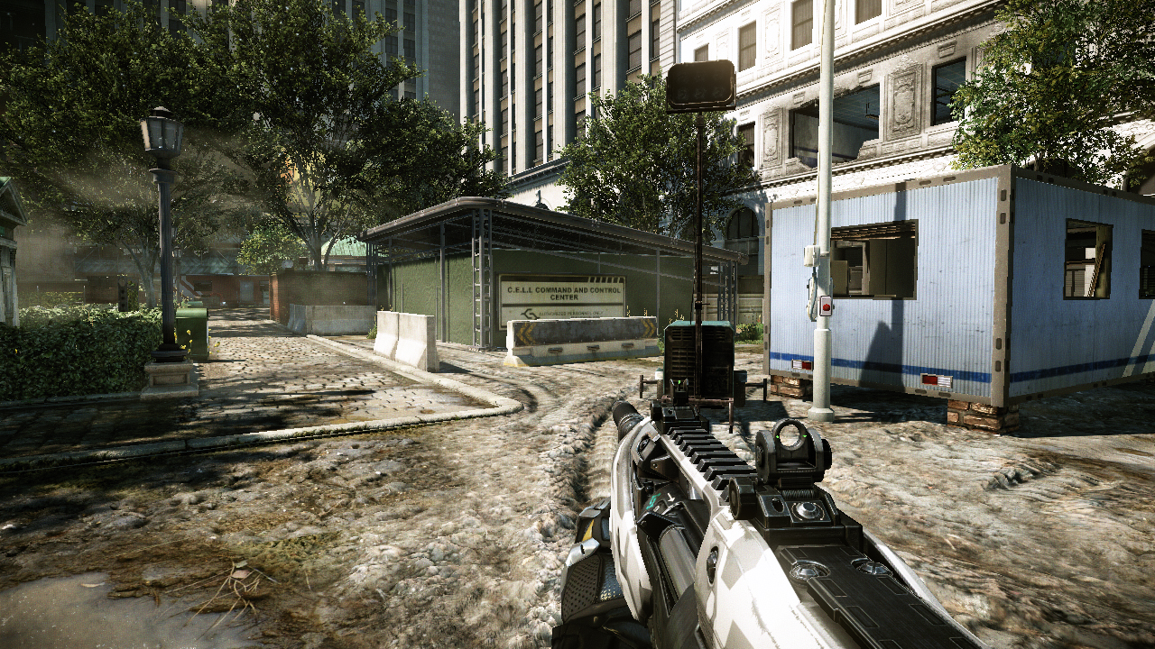
No AA

Slide 10
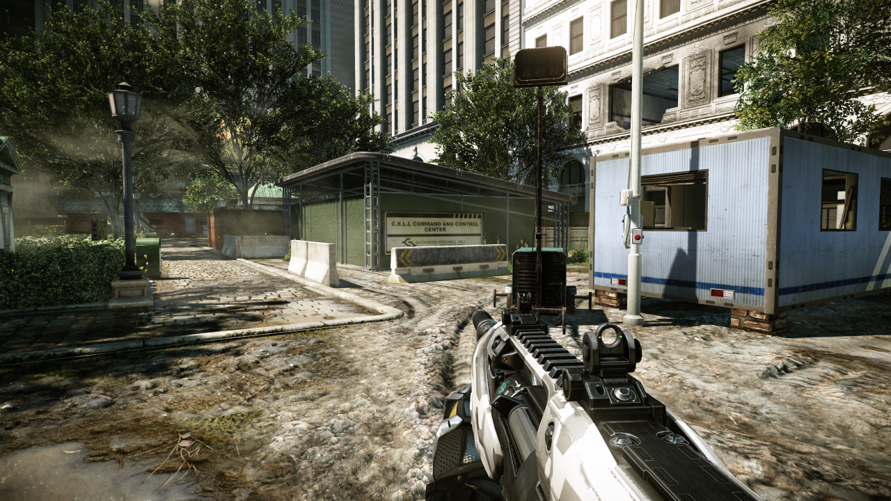
16x SSAA

Slide 11
Distribute A-Buffer SSAA Overframes
Running at 60 fps ?
Add sub-pixel jitter to camera frustum every frame
Store previous/current frame and linear blend them
Light-speed 2x SSAA: ~0.5 ms on current consoles
2 frames ⬄ 2x SSAA, 4 frames ⬄ 4x SSAA, etc
But... not many reach 60 fps on consoles
Lower fps results in extremelly noticeable image ghosting
Notes:
Used in few older 60 fps games (DMC4?) , but who was first?
And even at 60 fps, still noticeable ghosting

Slide 12
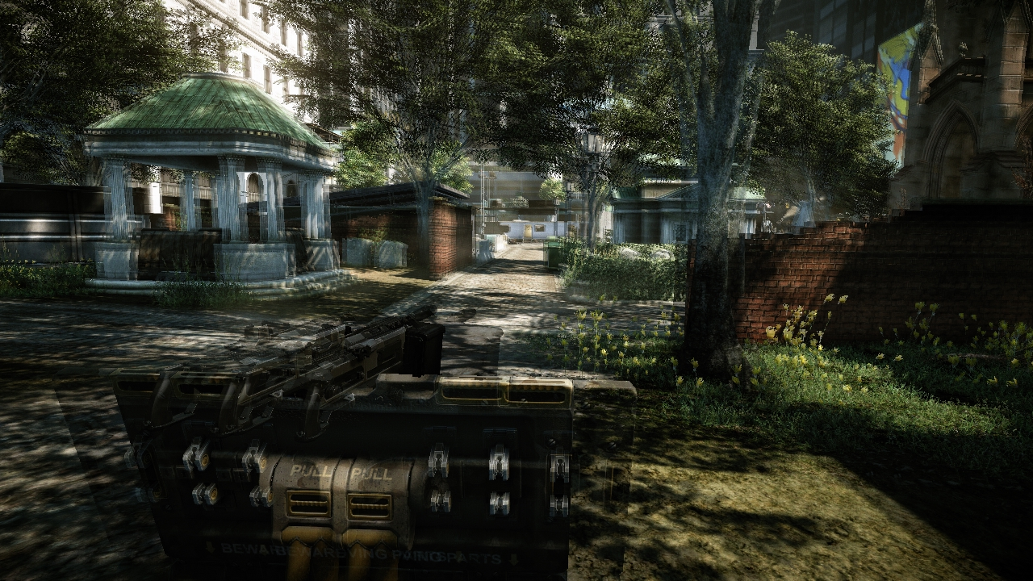
Linear blending => ghosting at low fps
Notes:
Strafing is the worst case, we’ll use if for images

Slide 13
Minimizing Artifacts
Improving blending: Reprojection
Velocity vector fetches from previous frame sub-sample target
Exactly same as in TAA (but single tap)
Deformable geometry slightly more expensive to handle
Output pixel velocity into a render target
Could not affort for vegetation
Problem: Disocluded regions ghosting

Slide 14
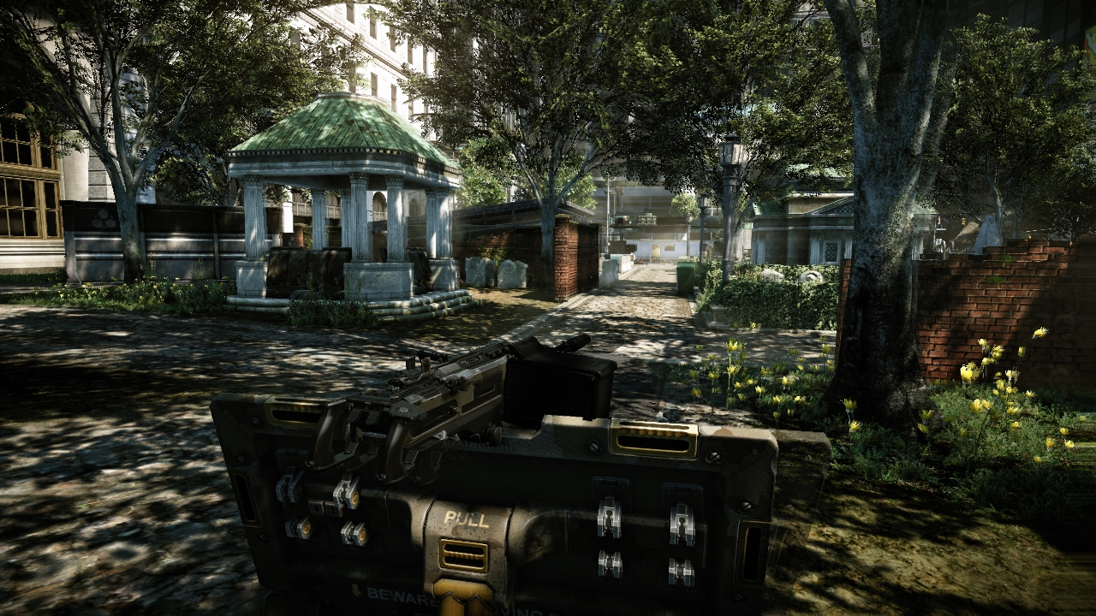
Using reprojection

Slide 15
Minimizing Artifacts (2)
Disable blending if ||V|| > 0?
Very rare the case when player not moving
And we still want AA during camera movement
Weighting using color/edge tagging ?
Sub-pixel/hi frequency detail results in noticeable schimering
Reprojection range clamping
Pixel weight proportional to reprojection limit
Eg: fBlendW = saturate( 1 - (fVLen / fVMaxLen) )
Coarse Depth stored in sub-sample buffer alpha channel
Mask out if fVLen > fMaxVThreshold and fCurrD > fPrevD
Notes:
Disable accumulation if ||V|| > 0?
Very rare the case when player not moving
And we still want AA during camera movement
Weighting using color ?
Sub-pixel/hi frequency detail results in noticeable schimering
Reprojection range clamping ? (used for Crysis 2)
Pixel weight proportional to reprojection limit
Eg: fBlendW = saturate( 1 - (fVLen / fVMaxLen) )
Coarse Depth stored in sub-sample buffer alpha channel
Mask out if fVLen > fMaxVThreshold and fCurrD > fPrevD
8 bit insufficient to cover large range, limited to nearby

Slide 16
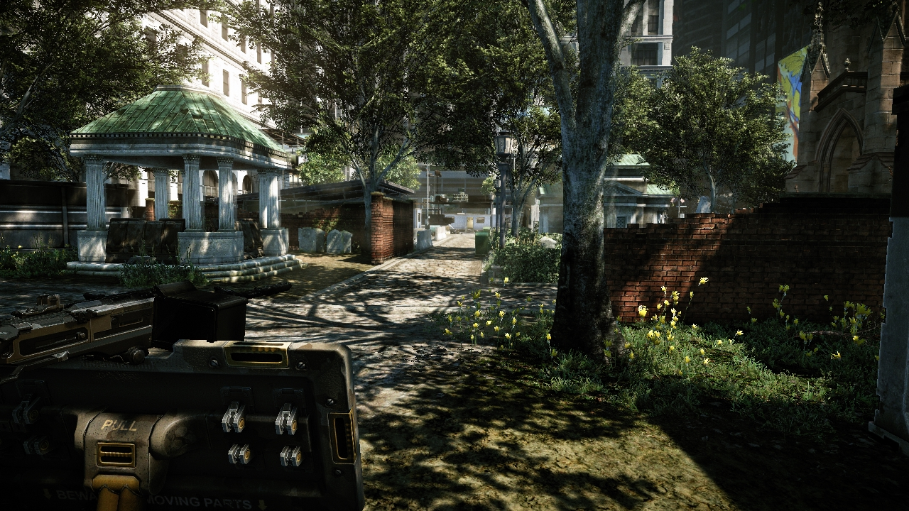
Clamped reprojection (used in Crysis2)

Slide 17
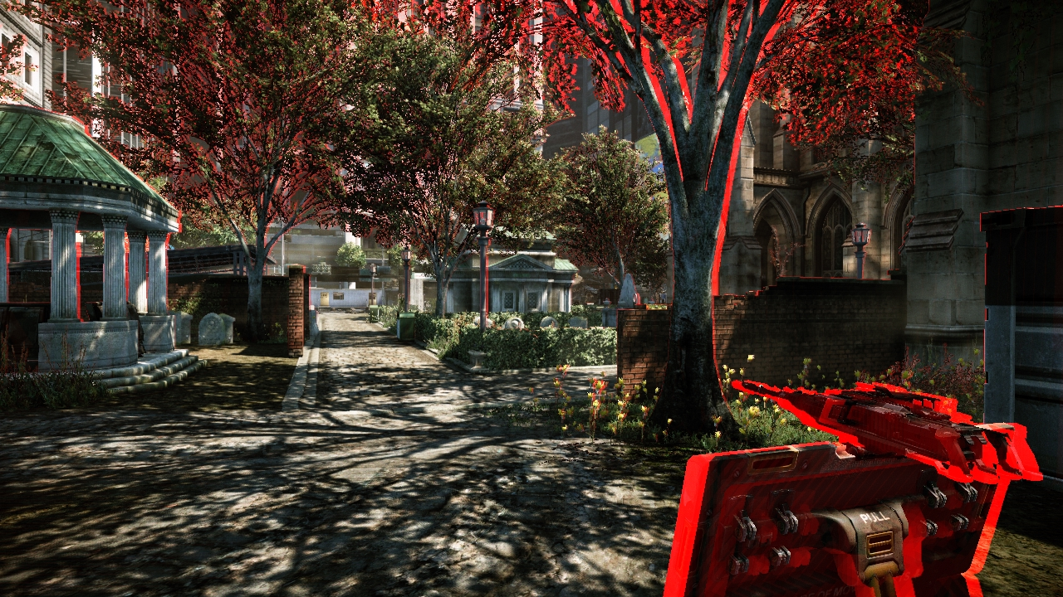
Minimizing Artifacts (3)
Store ||V|| in sub-sample buffer alpha channel
Weight: abs(fPrevLenV – fCurrLenV) / fVMaxLen

Slide 18
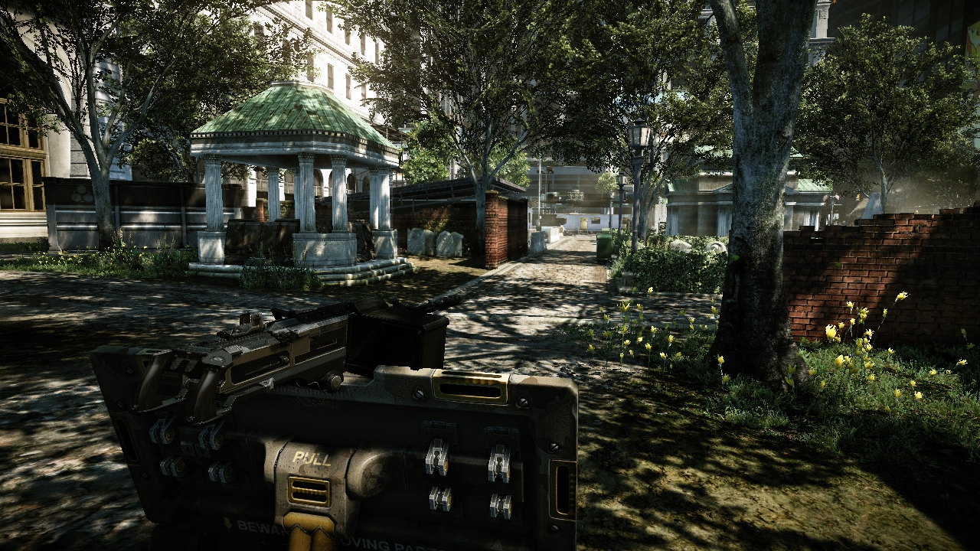
Clamped reprojection + Velocity weighting

Slide 19
Example Code
float fDepth = GetLinearDepth(sDepth, tcBase.xy );
float3 vPosWS = WorldViewPos.xyz + IN.vCam.xyz * fDepth;
float4 vPrevPos = mul(mViewProjPrev, float4(vPosWS, 1.0 ));
vPrevPos /= vPrevPos.w;
float2 vVelocity = vPrevPos.xy - tcBase.xy;
half4 cObjVelocityParams = tex2D(sObjVelocity, tcBase.xy) ;
half2 vObjVelocity = DecodeMotionVector( cObjVelocityParams );
vVelocity = cObjVelocityParams.w? vObjVelocity : vVelocity;
float fVLenSq = dot(vVelocity.xy, vVelocity.xy) + 1e-6f;
vVelocity /= fVLenSq;
half4 cCurr = tex2D(sCurrFrame, tcBase.xy)
half4 cPrev = tex2D(sPrevFrame, tcBase.xy + vVelocity * min(fVLenSq, fVMaxLen) );
half fBlendW = 0.5 - 0.5 * saturate(fVLenSq / fVMaxLen );
fBlendW *= saturate(1 - (abs(cCurr.a – cPrev.a) * fVWeightScale );
OUT.Color = lerp(cCurr, cPrev, fBlendW);

Slide 20
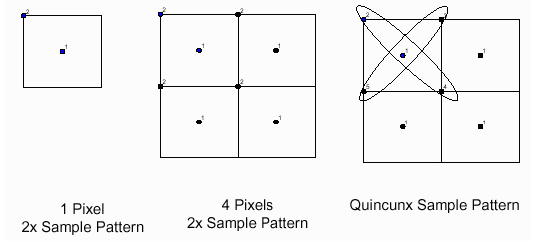
2x Quincunx SSAA
Improving quality with 2 sub-samples
Bilinear fetch to one of sub-samples
“Aproximate” 4x SSAA

Slide 21
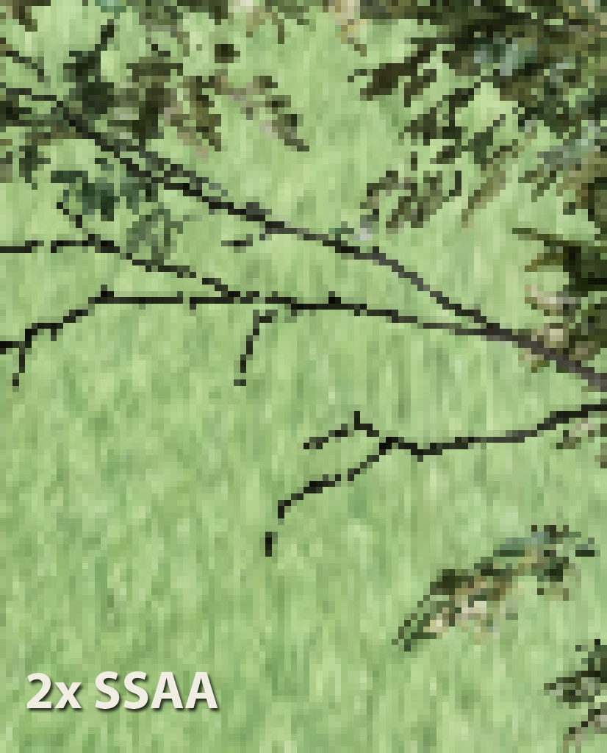
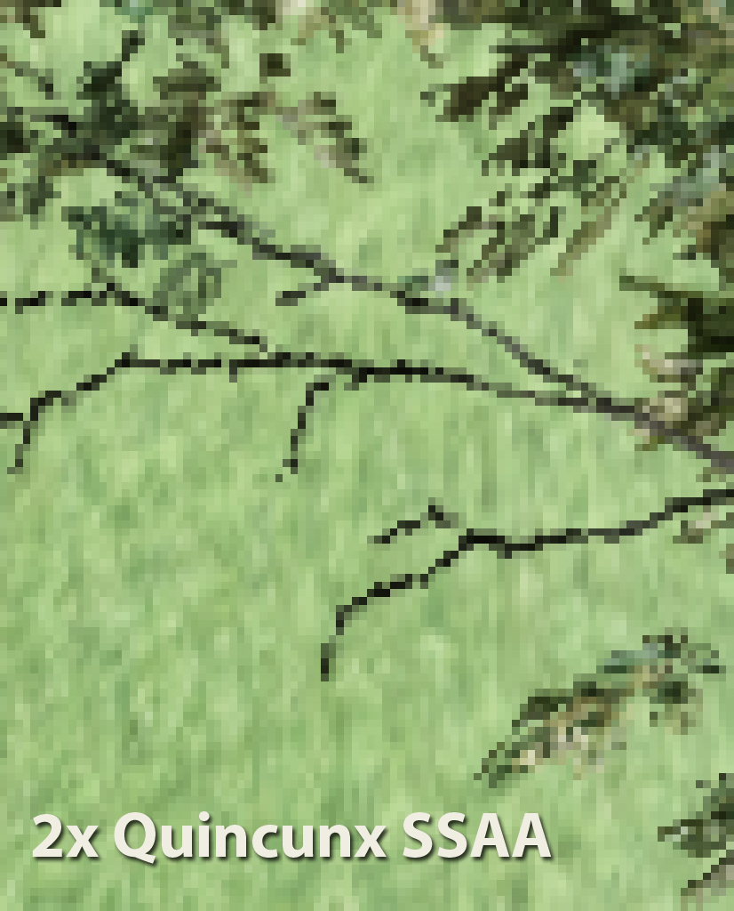
2x Quincunx SSAA

Slide 22
Distributed A-Buffer SSAA: Caveats
Not temporally stable
No AA on disocluded regions
Input signal changes (color/lighting), no robust solution yet
Alpha blending problematic
Withouth OIT, only possible to handle correctly for first hit
Additional overhead
Multi-GPU
Additional frame latency to address
For Crysis 2, we switched to Nvidia’s FXAA when in MGPU
Schimering was again, biggest complain from MGPU users

Slide 23
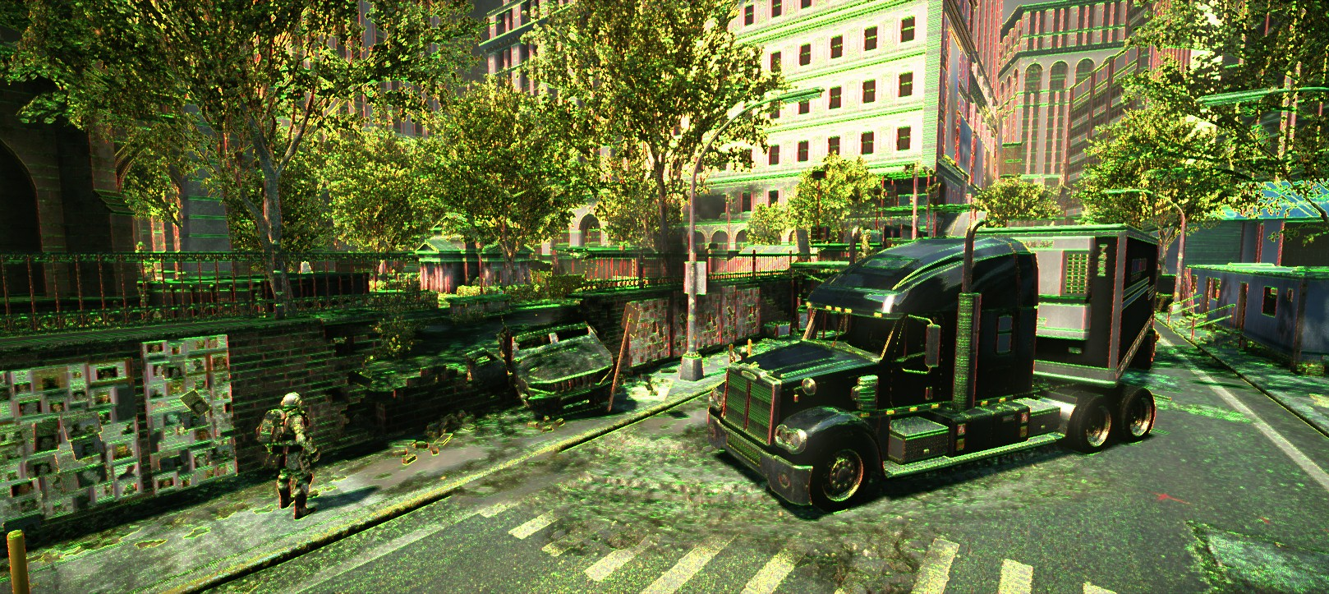
Future Work
SSAA combo with post processed AA
Maybe similarly to DLAA: horizontal/vertical edges, blend taps
This means at least 4 additional taps
AA on disocluded regions

Slide 24
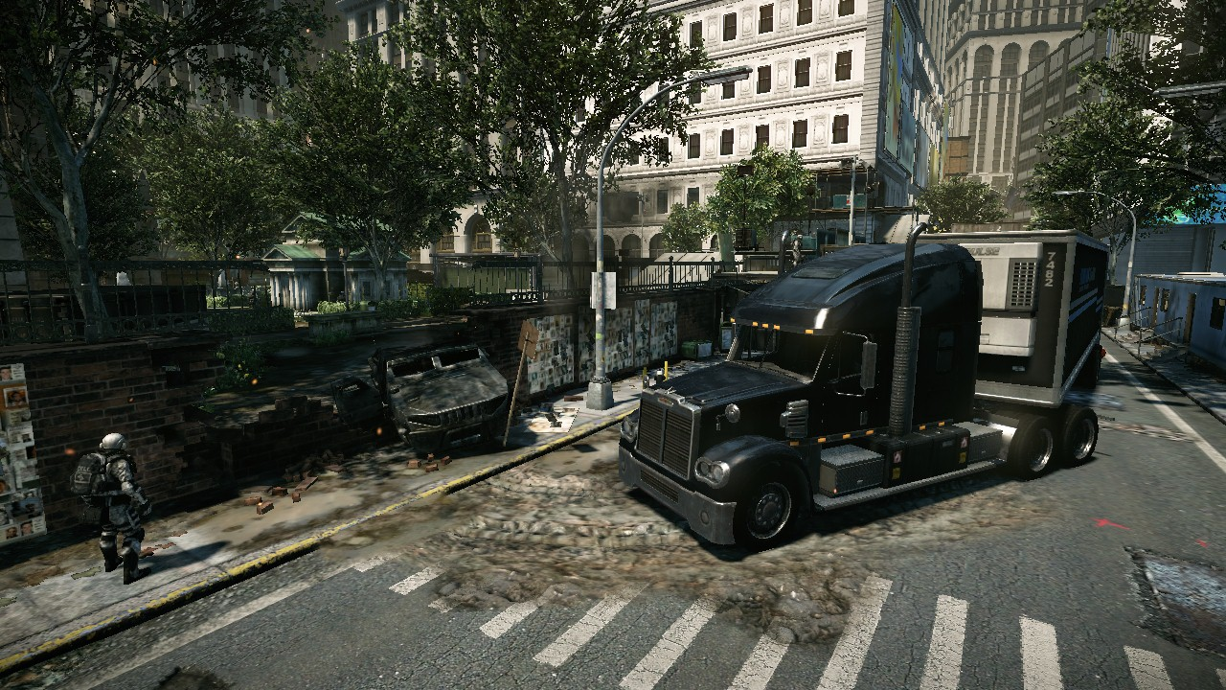
No AA

Slide 25
2x SSAA

Slide 26
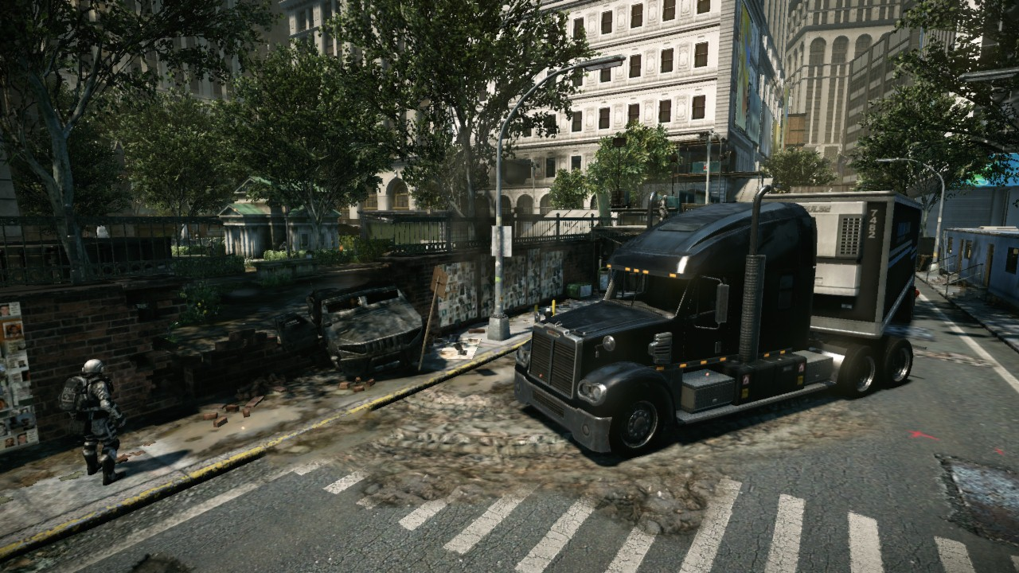
2x Quincunx SSAA

Slide 27
4x SSAA

Slide 28
4x SSAA + EdgeAA

Slide 29
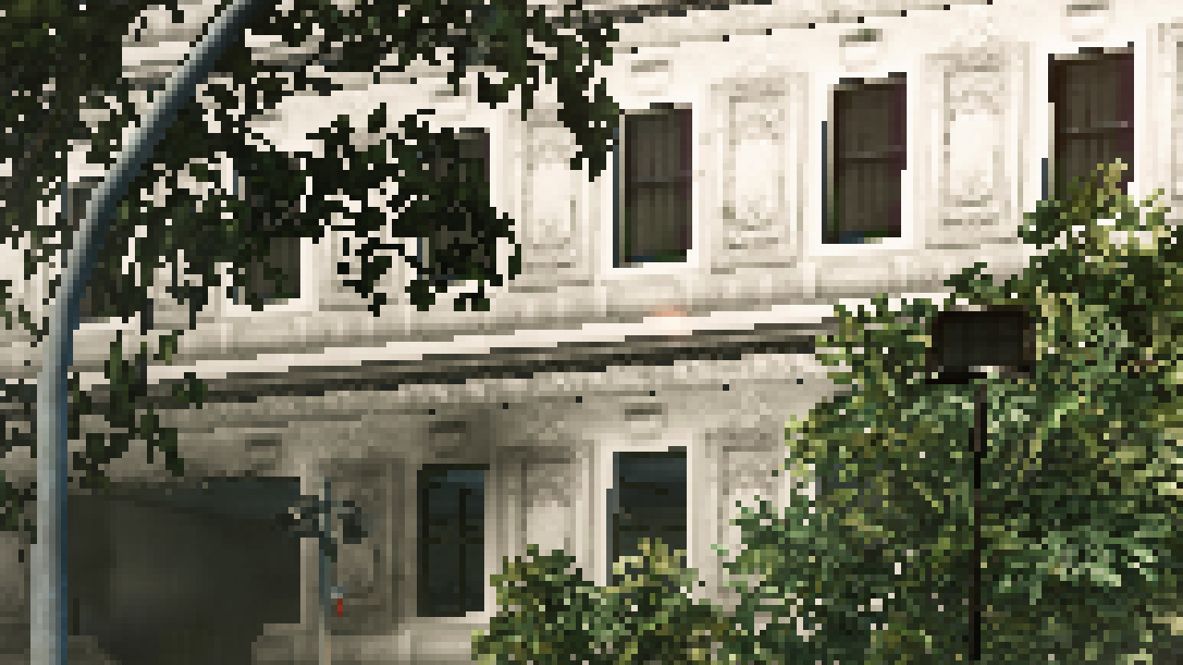
No AA

Slide 30
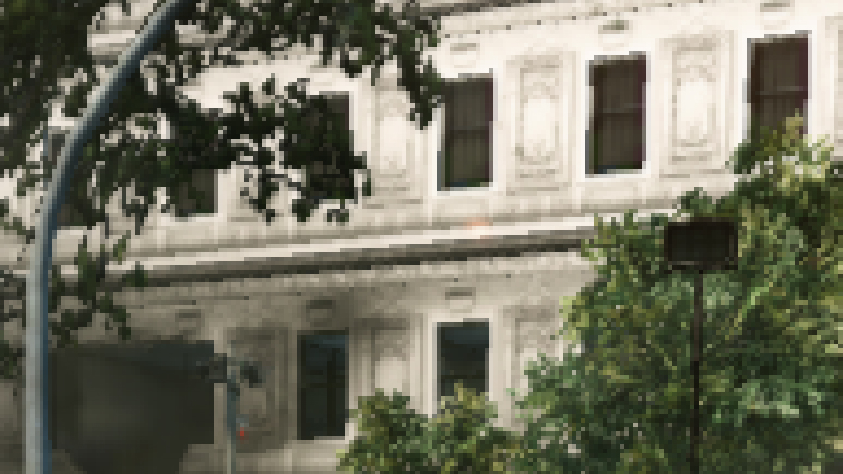
2x SSAA

Slide 31
2x Quincunx SSAA

Slide 32
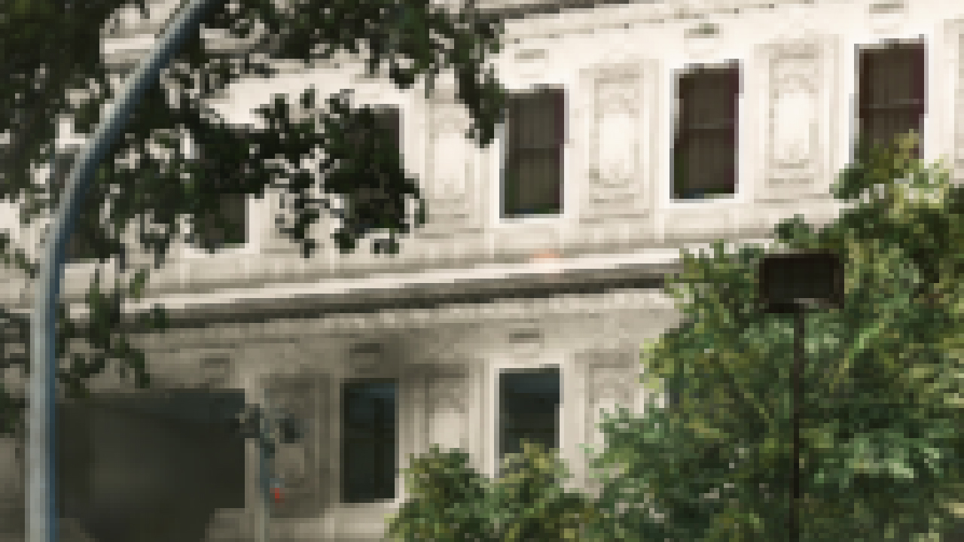
4x SSAA

Slide 33
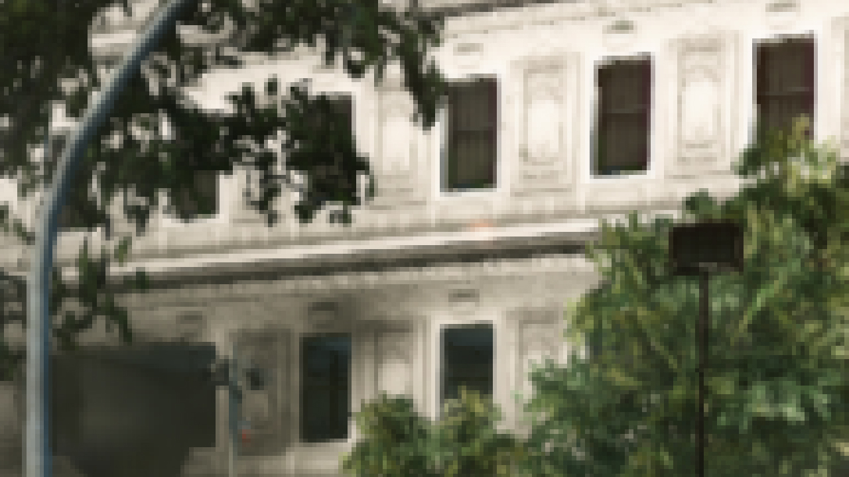
4x SSAA + EdgeAA

Slide 34
Distributed A-Buffer SSAA: Current Results
Far from perfect, but:
Orthogonal
Sub-pixel accuracy
Shader anti-aliasing bonus
2x Quincunx SSAA: 1 ms for consoles
0.2 ms at 1080p on pc’s
2x SSAA + edge AA: 1.7 ms
4x SSAA + edge AA: 2.2 ms
3 MB additional memory footprint
Notes:
Missing pretty pictures

Slide 35
Acknowledgements
Nick Kasyan,Nicolas Schulz, Vaclav Kyba, Michael Kopietz, Carsten Wenzel, Vladimir Kajalin, Andrey Konich, Ivo Zoltan Frey
Jorge Jimenez, Diego Guitierrez, Naty Hoffman
And to the entire Crytek team

Slide 36
Further Readings
Haeberli, P, Akeley, K “The Accumulation Buffer: Hardware Support for High-Quality Rendering”, 1990
Siggraph’96 Course , Blythe, D et al “Programming with OpenGL: Advanced Rendering”, 1996
Green, S “Stupid OpenGL Shader Tricks”, 2003
Sousa, T. “Crysis Next Gen Effects”, 2008
Swoboda, M “Deferred Rendering in FrameRanger”, 2009
Yang, G et al “Amortized Super Sampling”, 2010
Binks, D. “Dynamic Resolution Rendering”, 2011
Sousa, T., Kasyan, N. and Schulz, N. “Secrets of the CryENGINE 3 Technology”, 2011

Slide 37
Questions ?
tiago@crytek.com
twitter: crytek_tiago

Slide 38
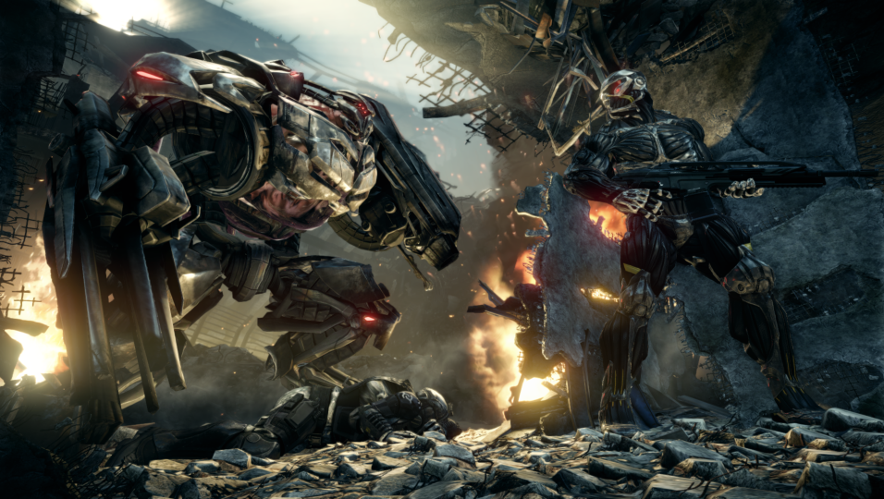
Bonus: Marketing Screenshots
Notes:
If time allows

Slide 39
Bonus: Marketing Screenshots
Always some trickery
On CryENGINE 2 rendered multiple tiles at big resolutions and downsampled to get SSAA
On CryENGINE 3 distributed SSAA with many samples
Random sub-pixel jitter
Almost perfect SSAA
All Crysis 2 marketing shots used this variation

